Slide 1
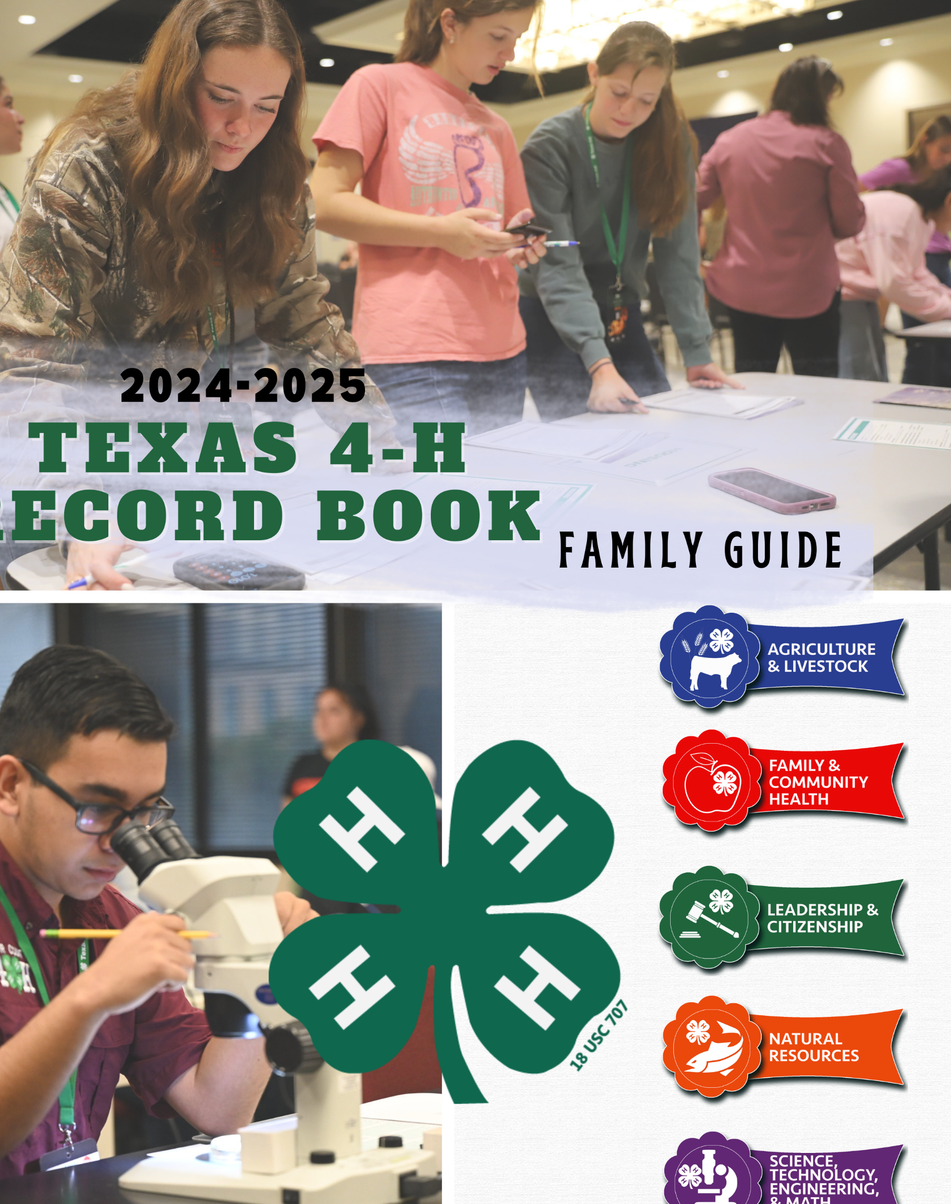
Record Books
2024-2025

Slide 2
Purpose/Objective of 4-H Record Book
Allow 4-H members to tell how they have grown, what they have learned, where they came up short and to do it creatively within outlined parameters.
Demonstrate the importance of keeping a written document of what has been done.
Provides a written platform for goal setting and documentation of the actions required to reach goals.
Provide an opportunity for competition at the County, District, and State level.

Slide 3
Steps to the Record keeping process
Goal setting
Journaling
Reflecting
Notes:
Goal Setting - Getting Started
Prior to or at the beginning of the 4-H year, a member should begin identifying, setting and recording personal goals for themselves in each project area. Parents, club managers, adult volunteers, and County Extension Agents play an important role in helping guide young people through this process. Members should record their personal goals and then begin work toward achieving those goals. It is important to record anything the member would like to learn or do.
Journaling - As Things Happen
Record keeping is going to be an important part of a member’s life. Members will keep records in high school, in college, and at work whether they own their own business or work for someone else. Now is the time to learn how to keep good records. The most important thing about 4-H record keeping is to find a comfortable way to collect information. Some of the most common ways of keeping up with 4-H records include a calendar, an index box, smart phone, computer, or a notebook. These are further defined below.
Reflecting – Looking Back
Below are some questions to help a member start reflecting on his/her project experiences as he or she prepares to complete a Record Book.
• What did you learn from your project(s)?
• Did you meet any of your goals? If so, what helped you attain those? If not, what were some
• obstacles that might have prevented you from reaching your goals?
• How did your project change or grow within the year or from previous years?
• Did you serve in any type of leadership capacity?
• What impact did your involvement have on you, your club, or community?
• How have your project experiences influenced your future career choice?

Slide 4
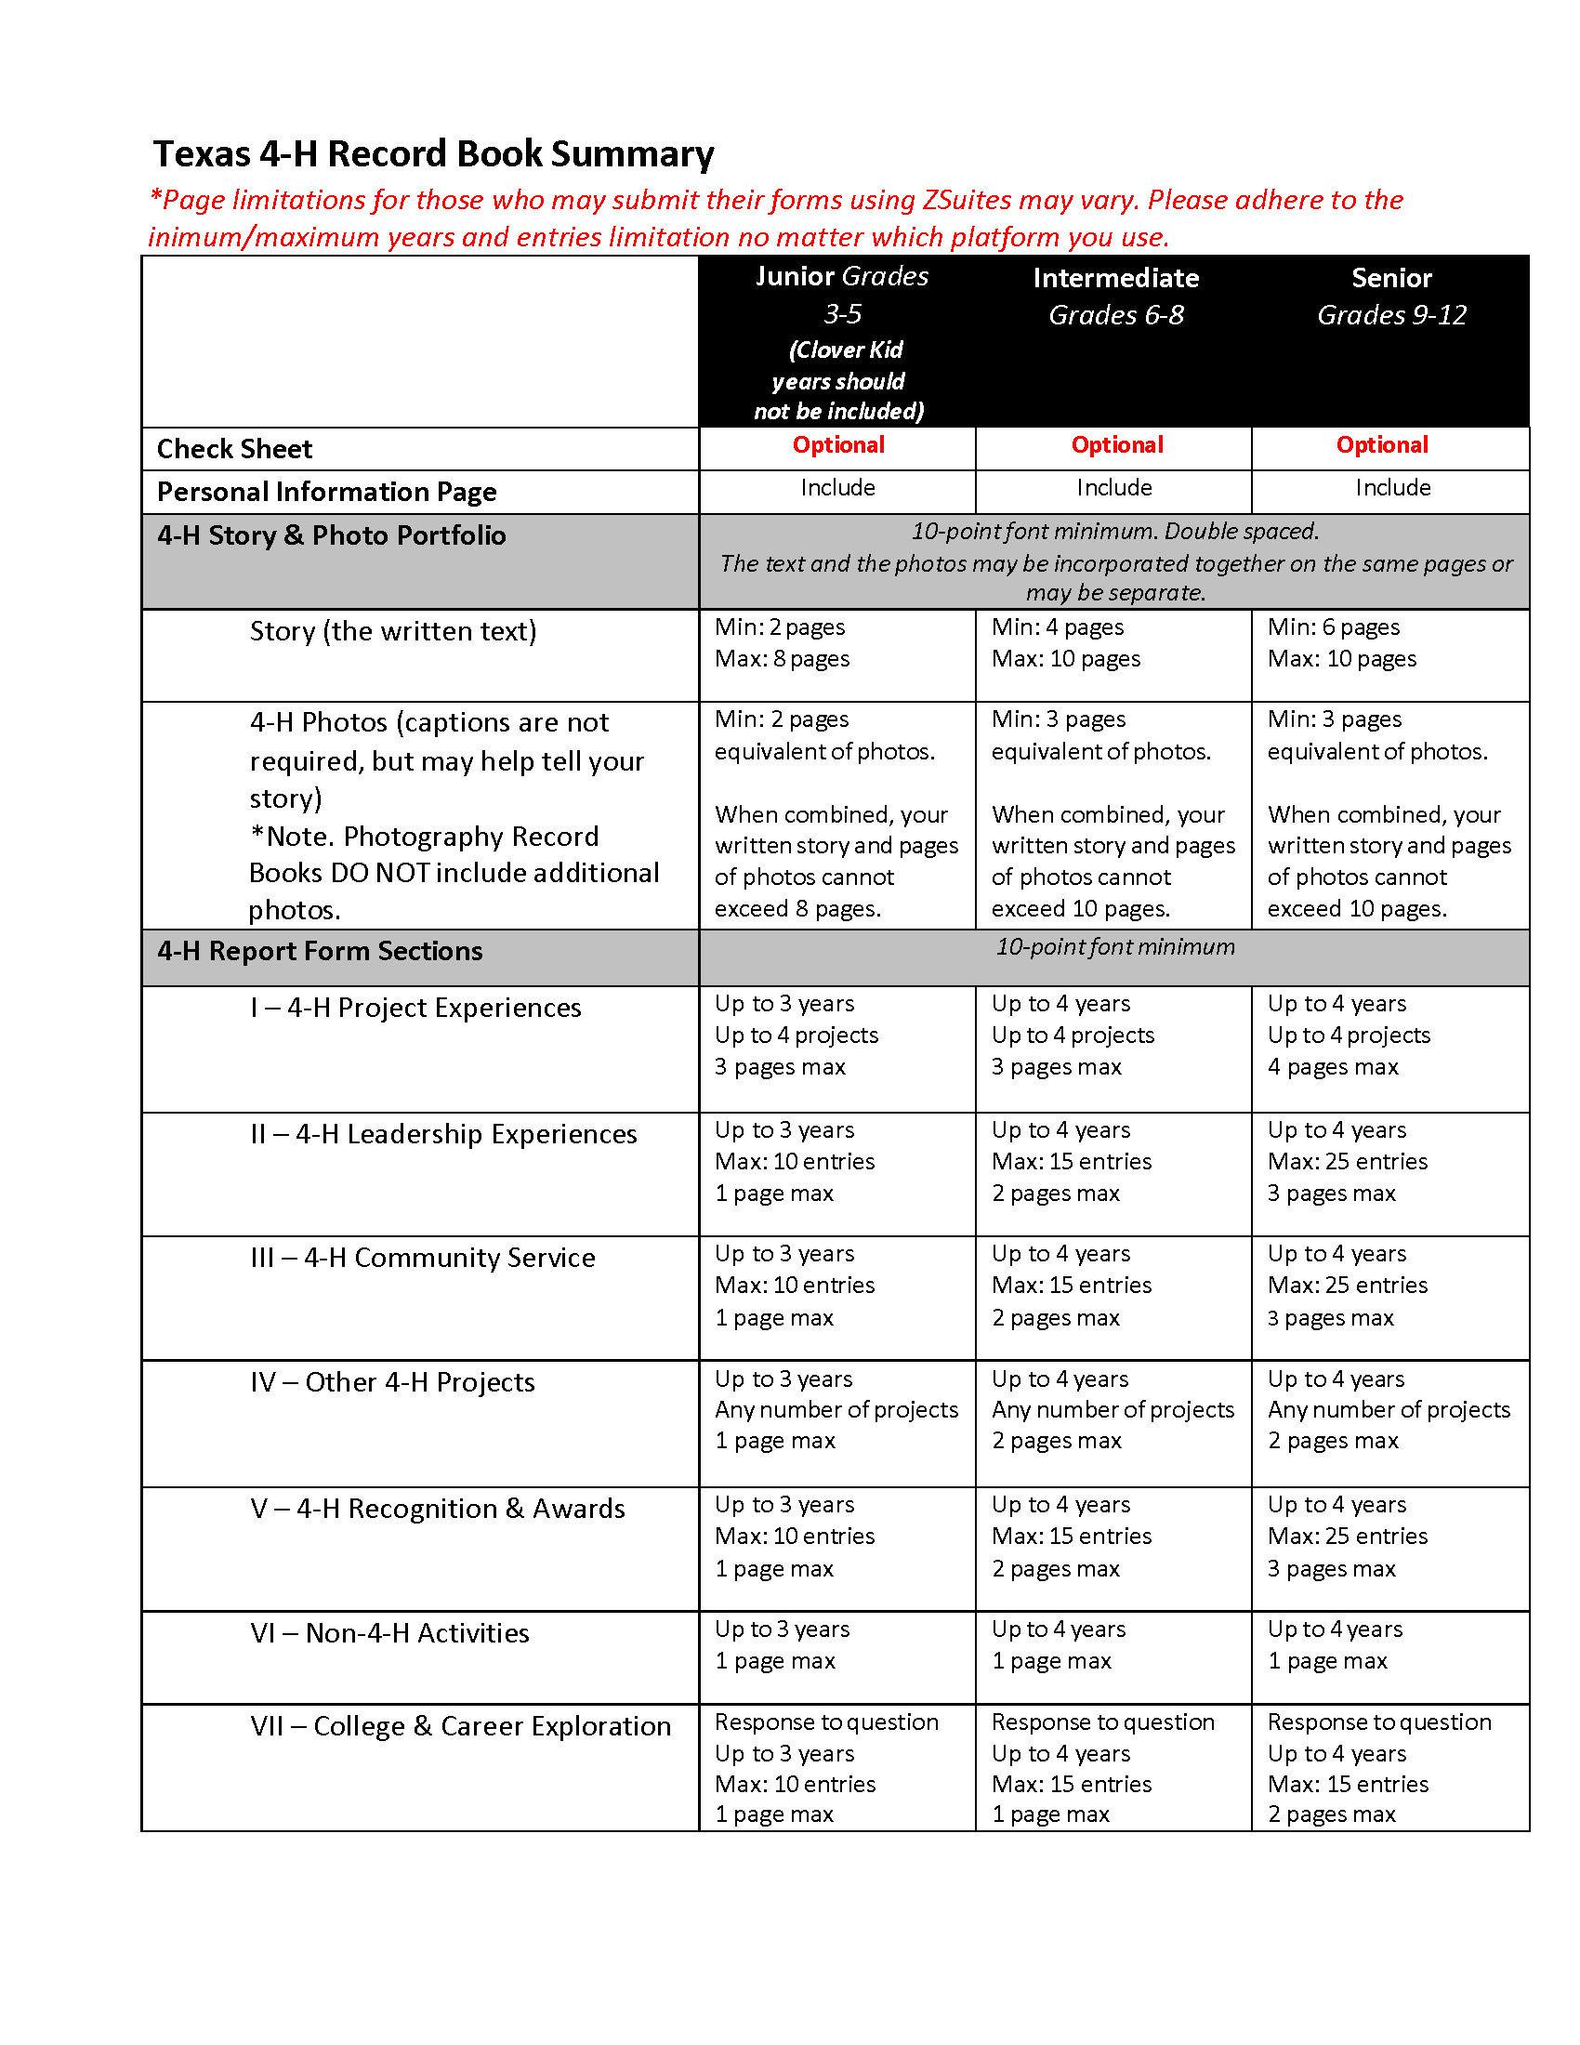
Record book at a glance
Notes:
A Texas 4-H Record Book consists of information that a 4-H member records over the course of a 4-H year that documents his/her goals, knowledge and skills gained, leadership experiences, awards earned, and service in his/her community. Those experiences are recorded into forms, narratives, and a story/photo portfolio written by the 4-H member. The information is printed, bound in a cover, and is typically submitted for evaluation.
Record Books contain 4 parts: (all three age divisions: Junior, Intermediate, and Senior)
1. Check Sheet
2. Personal Information Page
3. 4-H Story & Photo Portfolio
4. Report Forms

Slide 5
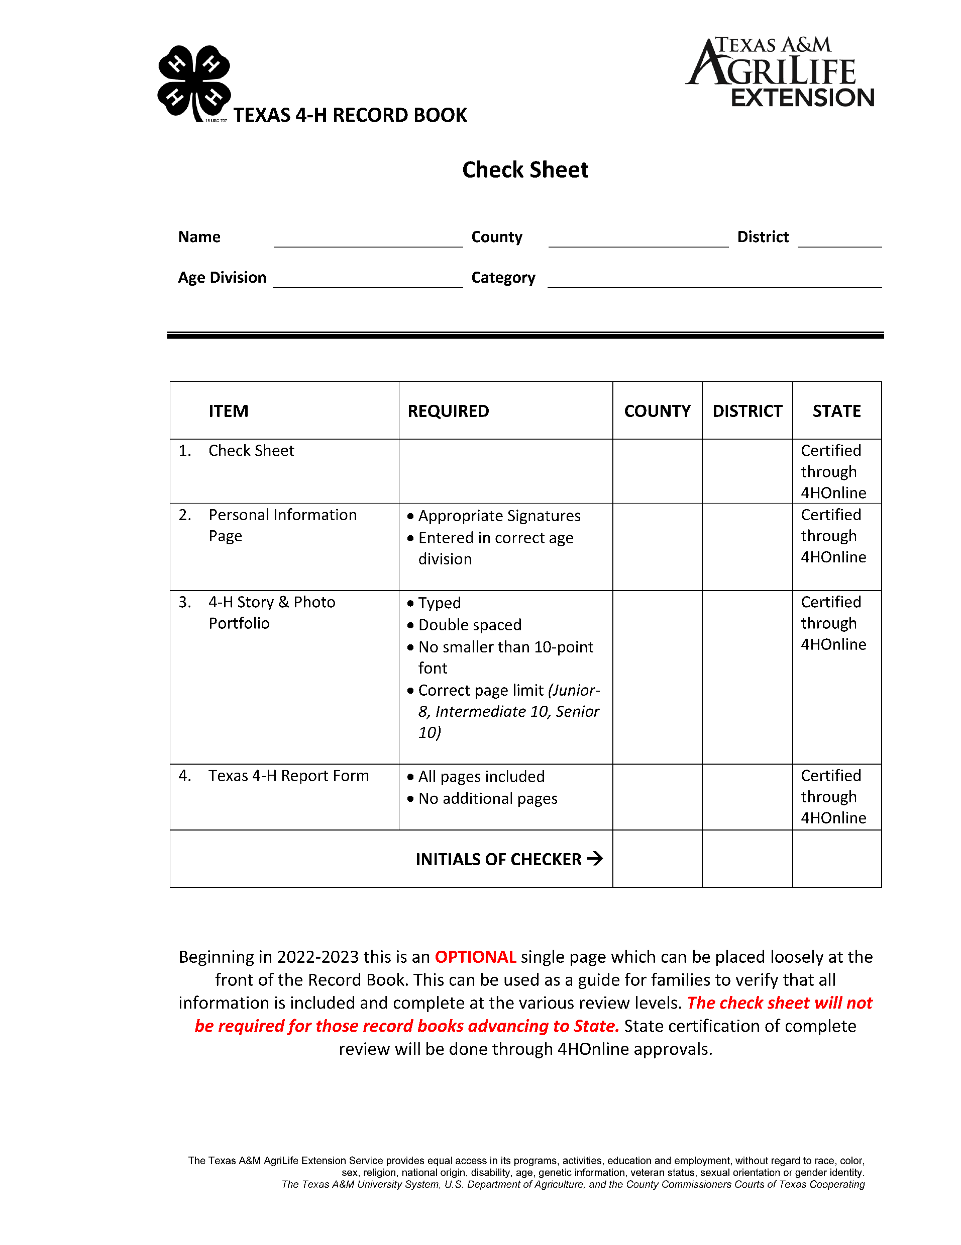
Check Sheet
Optional
Notes:
Check Sheet
Beginning in 2022-2023 this is an OPTIONAL single page which can be placed loosely at the front of
the Record Book. This can be used as a guide for families to verify that all information is included and
complete at the various review levels. The check sheet will not be required for those record books
advancing to State. State certification of complete review will be done through 4HOnline approvals.

Slide 6
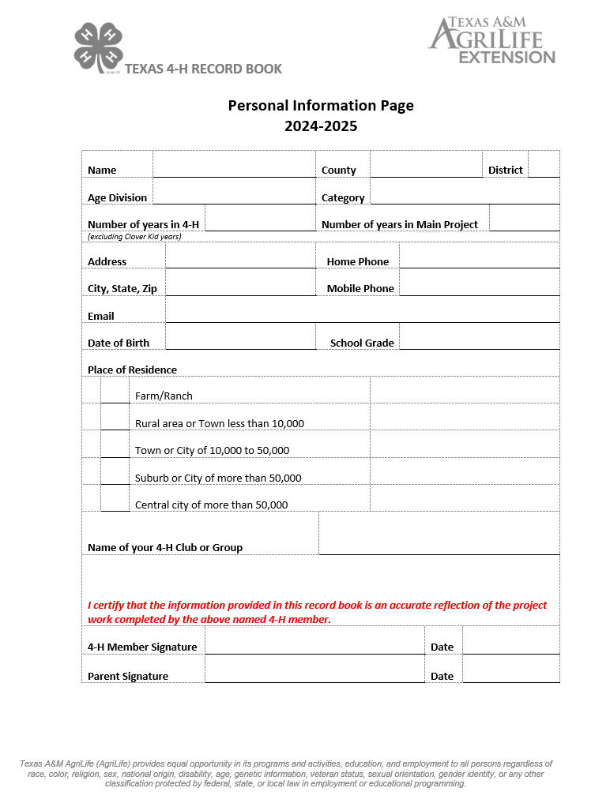
Personal information page
Notes:
Personal Information Page
A single page that contains personal contact information; used to verify the appropriate age division, category entered, and that information contained within the Record Book reflects the work of the individual submitting the records for evaluation. This information page is not judged. County Agent signature is not required since they are the ones that are advancing the record book to the next level. 4-H member and their parent are certifying the information presented is accurate.

Slide 7
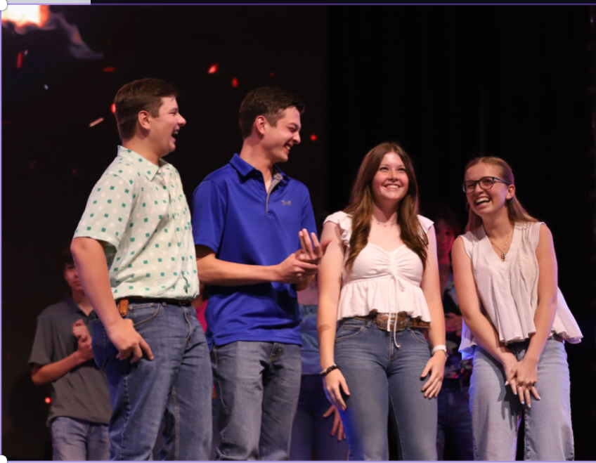
4-H Story & Photo Portfolio
The story should include information such as:
Information about yourself, your family, and your community
When and why you joined 4-H
Project Goals (Starting with your main project)
How 4-H has helped you become a better leader and citizen and what you have learned through your community service and leadership activities
How being a 4-H member has helped you set goals (include the goals) and develop new interests, and if 4-H has influenced your future plans or career goals
Notes:
The story should focus on information from the current year; however, it may also include information from prior years. Title the portfolio as follows: “My 4-H ___________ (Record Book Category) Story and Photo Portfolio.” For example, “My 4-H Horse Story and Photo Portfolio.” A subtitle may be added.

Slide 8
4-H Story & Photo Portfolio
The 4-H Story/Photo Portfolio should not just be a repetition of what is in the Report Forms
Include new information, expand on the entries to ‘tell the story’ of your 4-H project work.
Captions help tell the story and describe what is in the photo but are not required. Story and photos may be combined.
Notes:
The photos used are very important and should reflect growth, development and involvement in the member’s 4-H career. Use photos that show the member doing things, learning and teaching others, and especially having FUN in 4-H. Use photos that show the main project, other projects, leadership, and community service.
Photos depicting family activities, livestock auctions, U.I.L., sports events, other school events (non-4-H related photos) are not to be included. This is your 4-H Record Book.
Color and/or black and white photos, clear sharp copies of photos (scanned and/or color copied), and newspaper photo clippings may be included. Newspaper articles are not allowed.

Slide 9
4-H Story & Photo Portfolio
The combined portfolio should be completed within the page limits listed in the Texas 4-H Record Book Summary (page 5) for each age division.
Text is to be double-spaced type, using a minimum of a 10-point or equivalent size font.
Photos may be placed throughout the story, adhering to the minimum number of equivalent pages as listed on page 5 or they can be all grouped together.
Effective September 1, 2018 - Record Books submitted in the Photography category follow the same guidelines regarding number of photos included. DO NOT include extra photos.
Notes:
Don’t forget to take pictures throughout the year of 4-H projects and activities. Take active shots where you are engaged in learning, leading, or serving. Photos with awards are great for your documentation, but you want to show how you got there. Waiting until the last minute and having to pose or create false photos is not recommended.

Slide 10
Report Form
Same form for all age divisions
Request same content
Number of allowable entries varies
Current year and three preceding calendar years
Notes:
Effective September 1, 2018, the Report Forms for each age division (Junior, Intermediate, and Senior) request the same content. However, the number of allowable entries and pages vary by age division. The 4-H member may include information for the current year, plus up to three previous years on the Report Form. The 4-H member will only complete ONE Report Form each year that includes up to four years of information. (NOT four Report Forms with one year per form). Previous years’ Report Forms should not be included. Please see table below for more details.

Slide 11
Section I
4-H project experiences
What is your project? How did your project change or grow? What have you done and what have you learned?
You can include learning experiences gained in other youth/community organizations but applicable to the 4-H project.
Individual directed project learning experiences are also acceptable.
Include up to 4 projects, current year and up to three preceding 4-H years (up to two preceding years for Juniors).
Maximum page limits: Junior - 3 pages (updated 5/8/2023); Intermediate – 3 pages; Senior – 4 pages.
Notes:
List all of the cool and neat things that the member has done and learned that are related to his/her 4- H projects. This is the member’s opportunity to tell the world: “Look at the cool stuff I have been doing!” Include activities such as, but not limited to, workshops, contests, tours, research, computer learning programs, study of written material, interviews, etc. These learning activities may be completed in a project setting or may be the result of an independently conducted project; they may also have been completed in other youth or community organizations as long as they connect back to the 4-H project. Report the learning that took place.
Learning experiences are those activities in which the 4-H member has been a participant and not a teacher or instructor. Project-related leadership experiences should be reported as Volunteer Leadership in Section II.
Leadership and Citizenship are listed as projects just like Swine, Beef, Fashion & Interior Design, etc. Examples of leadership learning experience might include learning about different leadership styles, how to work with people, and effective communication.

Slide 12
Section II
4-H leadership experiences
Table includes : Year, Leadership Activity, Role, Level, Responsibilities/Duties/Accomplishments
List what you did to assist others throughout this 4-H year. Also include general leadership such as Club Officer, 4-H County Council, or County Committees.
Include current year and up to 3 preceding 4-H years of activities (up to 2 preceding 4-H years for Juniors).
Entry and page limits: Junior – 10 entries and 1 page; Intermediate – 15 entries and 2 pages; Senior – 25 entries and 3 pages
Notes:
Remember, everything done in 4-H is at some level: club, county, district, state, national or international. The member needs to let others know the level of participation in these activities. Code each experience by using: “Cl” = club; “Co” = county; “D” = district; “S” = state; “N” = national; and “I” = international
4-H leadership experiences are the most important things that tell others how the member has been involved in teaching and leading. The Texas 4-H Report Form provides two pages for the member to tell about these leadership experiences. The 4-H member should be able to demonstrate leadership in three different areas:
• Promotion
• Volunteer
• Elected
• Appointed
Promotion leadership should explain, “How have you told someone about 4H?” This may include activities such as wearing a 4-H T-shirt to school, getting a picture related to 4-H in the paper, speaking on the radio about 4-H, or riding on a 4-H float during a parade.
Volunteer leadership should explain, “How and what did I do to lead or teach others in 4-H?” Examples of volunteer leadership include: led the Pledge of Allegiance at the 4-H meeting, demonstrated how to measure a tablespoon at a 4-H club meeting, or organized a 4-H workshop or give a presentation on a specific topic.
Elected/Appointed leadership explains, “What did you do to improve 4-H?” This includes leadership in volunteering to serve on a committee like the telephone, recreation, and/or refreshment committee, and in serving in any elected office such as president or reporter of the local club, county 4-H council and or district/state council, and ambassador groups.
Do NOT include leadership that occurred as part of performing a community service activity. Providing primary leadership to a community service effort should be reported in Section III.

Slide 13
Section IIi
4-H community service
Table includes : Year, Your Role, Service Activity & Importance & Impact
List community service or service-learning projects that might include: clean ups, collections, repairs, construction, care packets, visitations, education, donations, presentations, etc.
Include current year and up to 3 preceding 4-H years of activities (up to 2 years preceding 4-H years for Juniors).
Entry and page limits: Junior – 10 entries and 1 page; Intermediate – 15 entries and 2 pages; Senior – 25 entries and 3 pages
Notes:
Community service is the opportunity for 4-H members to go out into the community and help others, or to improve the quality of the town and the lives of those around them. How do you know if what you have been doing is community service? Ask yourself: “What did I do to help other people because of 4-H?”
Community service activities should be “coded” by the amount of community service, number of persons involve in the activity and number impacted by the activity.
There are three codes that reflect this:
• Y = Yourself – this was a community service project that you did all by yourself with no help from other 4-H members or club.
• P = Provided Primary Leadership – you were the organizer, you made all the arrangements, and recruited other 4-H members to help you.
• M = Member of a Group – when another 4-H member called asking for help, you were there as a worker and helper.
Note: This section is for community service activities only and not for citizenship experiences (citizenship is a project; see category description document for more details).

Slide 14
Section IV other 4-H projects
Include current year and up to 3 preceding 4-H years of activities (up to 2 preceding 4-H years for Juniors)
Limit to 1 page (junior)
Limit to 2 pages (intermediate and senior)
Any number of projects
List any 4-H project(s) not listed in Section I, include number of years and summarize participation.
Notes:
Tell briefly about other 4-H projects not listed in Section I. These are not the 4-H member’s main project area but have enhanced the individual’s 4-H experience. Be sure to summarize the project knowledge and skills gained.

Slide 15
Section V
4-H Recognition and awards
Year, Level, Recognition, Importance to You
Include current year and up to 3 preceding 4-H years of activities (up to 2 preceding years for Juniors).
Entry and page limits: Junior – 10 entries and 1 page; Intermediate – 15 entries and 2 pages; Senior – 25 entries and 3 pages
Notes:
Awards and recognition are important in the 4-H program. They provide an opportunity for 4-H members to be recognized for all of their hard work and dedication to a 4-H project, leadership provided to others, community service activities, and of course for being the “best all-around 4- H member.”

Slide 16
Section VI
Non 4-H activities
Include
Include current year and up to 3 preceding 4-H years of activities (up to 2 preceding years for Juniors)
Limit
Limit to 1 page
List
List leadership, community service, awards, and recognition from OTHER activities such as school, church, and other community organizations
Notes:
This section allows the member to show off school, church, Boy Scouts, Girl Scouts, or other youth organization activities, leadership, community service, and awards and recognition.

Slide 17
Section VII college/career exploration
Answer : As of today, what career would you choose?
List activities that have helped you learn more about careers or the necessary education to enter a career. Examples of activities include: interviews, tours, job shadowing, research, mentoring, work experience, skill development, course work, etc.
Include current year and up to 3 preceding 4-H years of activities (up to 2 preceding years for Juniors).
Entry and page limits: Junior – 10 entries and 1 page; Intermediate – 15 entries and 1 page; Senior – 15 entries and 2 pages
Notes:
List 4-H and non-4-H activities that have helped the member learn more about careers or the necessary education to enter a career of interest. Examples of these activities include: presentation by professional, interviews, tours, job shadowing, research, mentoring, work experience, skill development, course work, etc.

Slide 18
Books Submitted for Evaluation
Clarification on learning activities that take place outside of 4-H clubs and project groups
What will Judges look for?
Notes:
What will judges look for? Record Books submitted for competition will be evaluated based on project work, leadership, community service, awards, and non-4-H activities. Please refer to the score sheet for judging criteria.
Record Books will be judged primarily on content. Emphasis will be placed on the quality of the member’s experiences, activities, leadership, service, and accomplishments. When readers look at a Record Book, they take into account the details in relation to how long the member has been in 4-H.
Clarification on learning activities that take place outside of 4-H clubs and project groups
Very often 4-H members can enhance their 4-H project learning experiences by participating in activities beyond the 4-H club/project. Example, a youth may participate in a showmanship clinic sponsored by a cattle breed association. The learning that takes place and the practice of showing transcends to their 4-H project and thus should be reported in the Report Form. However, if that same 4-H member competes in a showmanship competition sponsored by the breed association that would be reported as a non-4-H activity.
Another example may be in the Theatre and Performance Arts category where many learning experiences may take place within a community theatre or through school theatre. The knowledge, skills and practice associated can be reported as learning experiences within the Report Form. A competitive event or production, however, would be reported as a non-4-H activity.
4-H members also lead self-determined projects where they may be the only individual in their club or county with that particular interest. Learning activities that are self-directed are to be included and reported just as any other project learning activity.

Slide 19


We will be potentially phasing out the use of Zsuites starting
2025-2026 online app at https://4h.zsuite.org/
Information required is the same for either method
Notes:
We are currently working to develop another option for online record keeping. We are exploring the option to phase out the Zsuites beginning in 2025-2026. We will notify all users prior to making the adjustment.

Slide 20
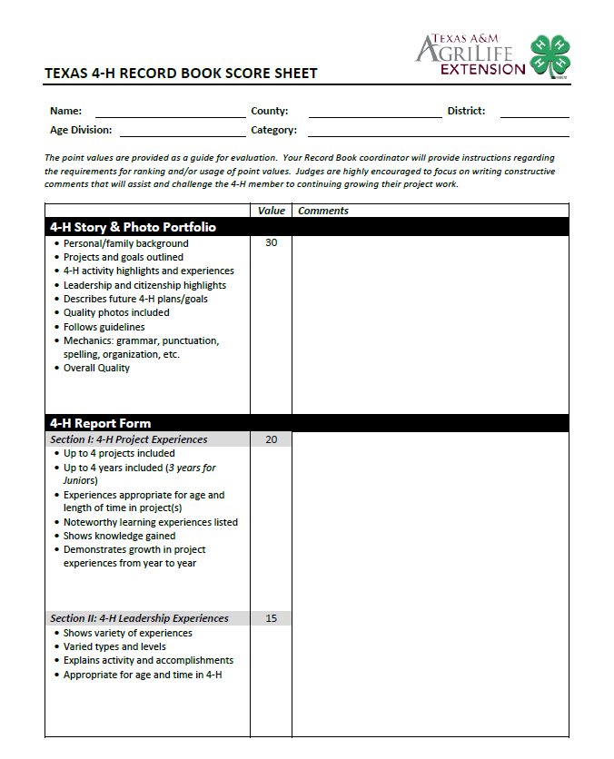
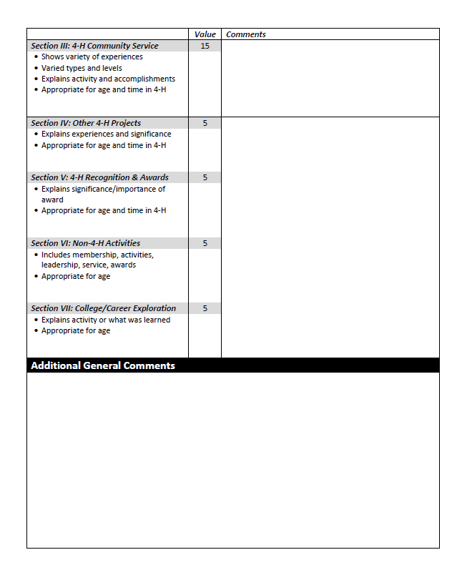
Score sheets

Slide 21
Record book cover
All types of covers or binders are accepted.
Official 4-H Record Book covers can be ordered from National 4-H Supply if desired.
Some county Extension offices may have a supply of these covers or may place county orders; check with them.

Slide 22
General Guidelines
Handwriting
Grammar and Punctuation
Text Margins
Paper Type
Creativity
Font
Notes:
Handwriting: Handwriting any part of the Record Book is acceptable. When doing so, make sure to write legibly.
Grammar and Punctuation: For all age divisions, members are encouraged to write using proper grammar and punctuation within the 4-H Story & Photo Portfolio. The Report Forms may be presented in a table or chart form.
Text Margins: Top, bottom and right margins must be between one-half and on inch. The left margin must be 1 1/2 inches to allow for hole punching
and binding.
Paper Type: Typing paper and bond weight paper are acceptable. Do not paste typing paper onto construction paper. Do not use sheet protectors
or dividers.
Creativity: This is encouraged, and can include the use of backgrounds, decorative elements, construction paper cutouts, etc. throughout
the 4-H Story & Photo Portfolio. Creativity varies from person to person and can also come in the form or style of writing.
Font: Color or black fonts are acceptable. Use a minimum of a 10-point font (equivalent in size to 10-point Arial).

Slide 23
Additional changes to note… effective 9/1/2018
Photography books include same number of photos as other categories
Old Report Forms will NOT be included in any book
Updated categories

Slide 24
Categories
Animal Agriculture
Beef
Citizenship & Civic Education & Community Service
Dog Care & Training
Consumer Education
Entomology
Fashion & Interior Design
Food & Nutrition
Gardening & Horticulture
Goat
Health and Personal Safety
Horse
Leadership
Natural Resources
Photography
Poultry
Public Speaking
Rabbit
Science, Technology, Engineering & Math (STEM)
Sheep
Shooting Sports
Swine
Visual & Performance Arts
Veterinary Science
Range Science and Agronomy
Notes:
A 4-H member will choose one of the categories for their Record Book entry. The category selected should be reflective of the 4-H member’s main (most active) project.
Review pages 16 – 19 of the Record Book Family Guide for descriptions of each category

Slide 25
Texas 4-H Record Book Winners
Senior 4-H members who win first place at the Texas 4-H Record Book Judging competition, MAY submit a Record Book in future years in the same category in which they earned first place.
State record book winners will earn the opportunity to attend the Texas 4-H Leadership Conference which is held during Thanksgiving break. Cost of the trip to the 4-H member is typically between $1,750-2,000.

Slide 26

Questions?
Contact Jana Barrett
Email : jcbarrett@ag.tamu.edu
Phone: 979-321-5287

