Slide 1

Fill in School, District Name or Organization
AGENT NAME(S)
SPECIALIST NAME (if applicable)
Notes:
(Good Morning remark)
Thank you for attending the Dancefit Curriculum Leader Training, we will be training you on how to successfully implement the program.

Slide 2

Welcome & Introductions
Dancefit
Curriculum
Overview
County
Nutrition
Programs
(delete if not applicable)
Dancefit
Choreography
Overview
Notes:
“Let’s start with the agenda and briefly view the topics we will be covering today.”
(Mention each topic)

Slide 3
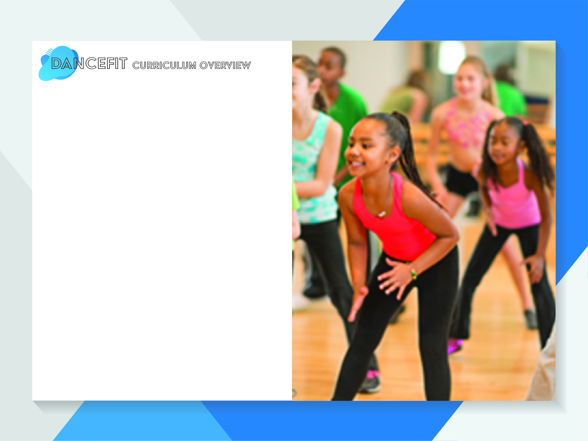
Dancefit provides youth with a great combination of physical activity, social interaction, mental stimulation, and fun!
Design allows for alignment with Physical Education TEKS in each lesson presented.
Benefits of Dance, according to CDC:
Cardiovascular system improves
Muscle tone increases
Burn calories
Increase flexibility, strength, and balance
Helps a person gain confidence
Allows you to be creative
Helps gives motivation and energy
Provides an enjoyable escape of normal daily routine, which gives a chance to relax, relieve stress, and concentrate on the joys of life
Notes:
“According to the Centers for Disease Control and Prevention cardiovascular exercise such as dance provides multiple health benefits.”
(Go over the health benefits)

Slide 4

Introduction
Lessons
Heart Health
Flexibility
Balance
Strength
Endurance
Calorie Burning
Appendix A: Sample Class Template
Appendix B: Choreography Notes
Appendix C: Activity Ideas
Appendix D: Common Core Standards
Appendix E: Sample After School Program
Appendix F: Cool Snack Recipes
Appendix G: Volunteer Position Description
References
Notes:
“Please take out the PDF copy of the curriculum that has been provided in the packet you received today. Let’s look at the first page that contains the table of contents. The table of contents provides a snapshot of the 6 lesson topics plus 7 appendixes of additional resources on implementation ideas and samples. After the table of contents you will notice an introduction section explaining the benefits of dance, dance history, safety tips, and tips for leading Dance programs. We will go over the tips during this presentation.”

Slide 5

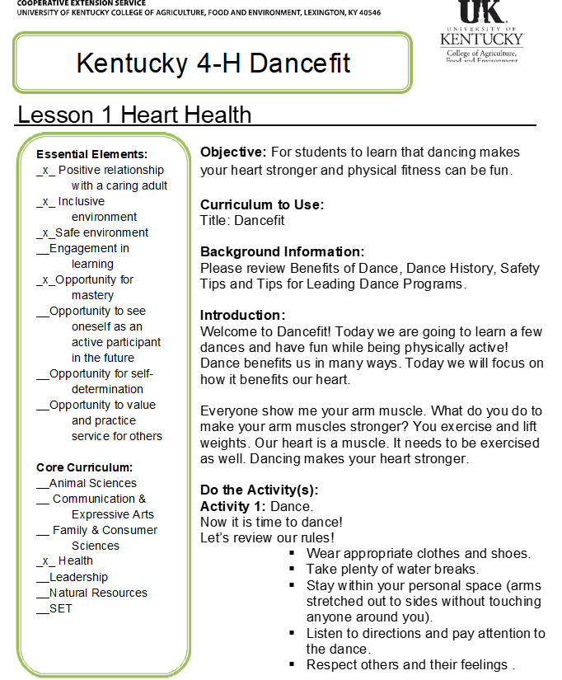
Each lesson contains the same core topics:
Essential Elements
Core Curriculum lesson
Objective of the lesson
Background information
Introduction
Activities List
Reflection
Question on how to apply the lesson
Extending learning i.e. nutrition lesson
Potential Partners
Volunteer/ Teen involvement suggestions
Supporting Multi-county/district/state events
Notes:
“Now let’s take a closer look at Lesson 1. Each lesson is formatted the same way and contains the same core topics.”
(Go through the core topics)

Slide 6
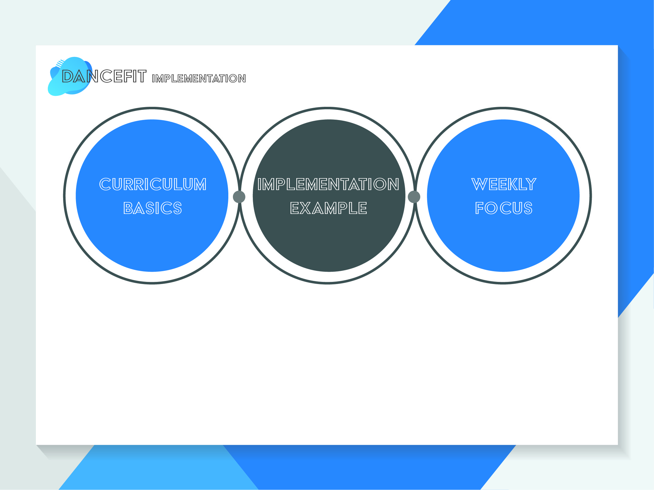
Basics
19 Dances
Choose 1 or 2 dances to review/ dance and perform them everyday for the entire week.
Move on to the next lesson for week 2 and choose 1 or 2 other dances to learn.
There will be dances ‘left over’ which you can choose to use if you revisit a lesson and continue for another 6 weeks.
At the end of the 6 weeks (12 wks.) have each student fill out an evaluation form or if they are PreK students answer them as a class and include the number of students per class.
Every week is focused on one lesson
6 Lessons
Notes:
“The great thing about Dancefit is that there are different ways to implement the program. Depending on how quickly your students pick up on the dance(s) or how much time you have to go through the dance(s) will be determine the number of dances you choose (1 or 2) each day for the entire week. The only thing that must stay consistent is the program lasts 6 or 12 weeks consecutively, pre-test must be completed before the program begins, and a post-test must be completed at the end of the program.”
(Go through the bullet points)

Slide 7
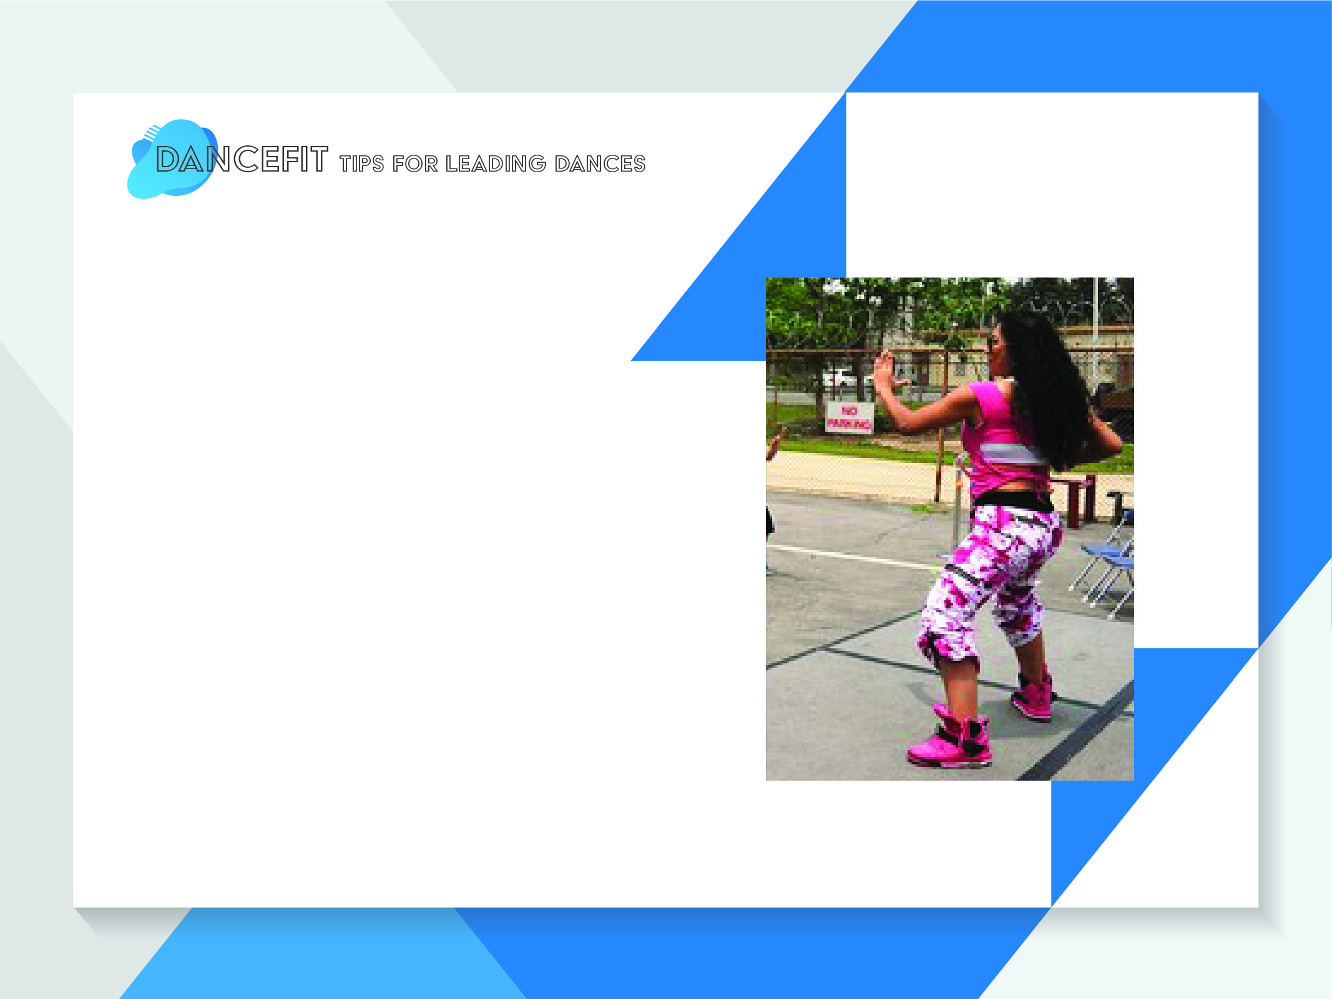
May choose any dances based on time allowed and age group
Go through each step:
  For example, demonstrate Step 1 (ensuring proper technique) then practice as a group, demonstrate Step 2 then practice as a group and then combine step 1 & 2, practice a couple of times and then go on to step 3. Go through the whole dance demonstrating each step and reinforcing proper technique.
For more complex dances teach a small piece and add onto it.
  Allow participants to practice the steps several times before adding onto the dance.
Go through the dance without music and then with music
Demonstrate proper form especially for squats and lunges
More tips in curriculum booklet
Notes:
“Now let’s go over tips for leading dances and you can find more tips before Lesson 1 in the curriculum.”
(Go over the bullet points)

Slide 8
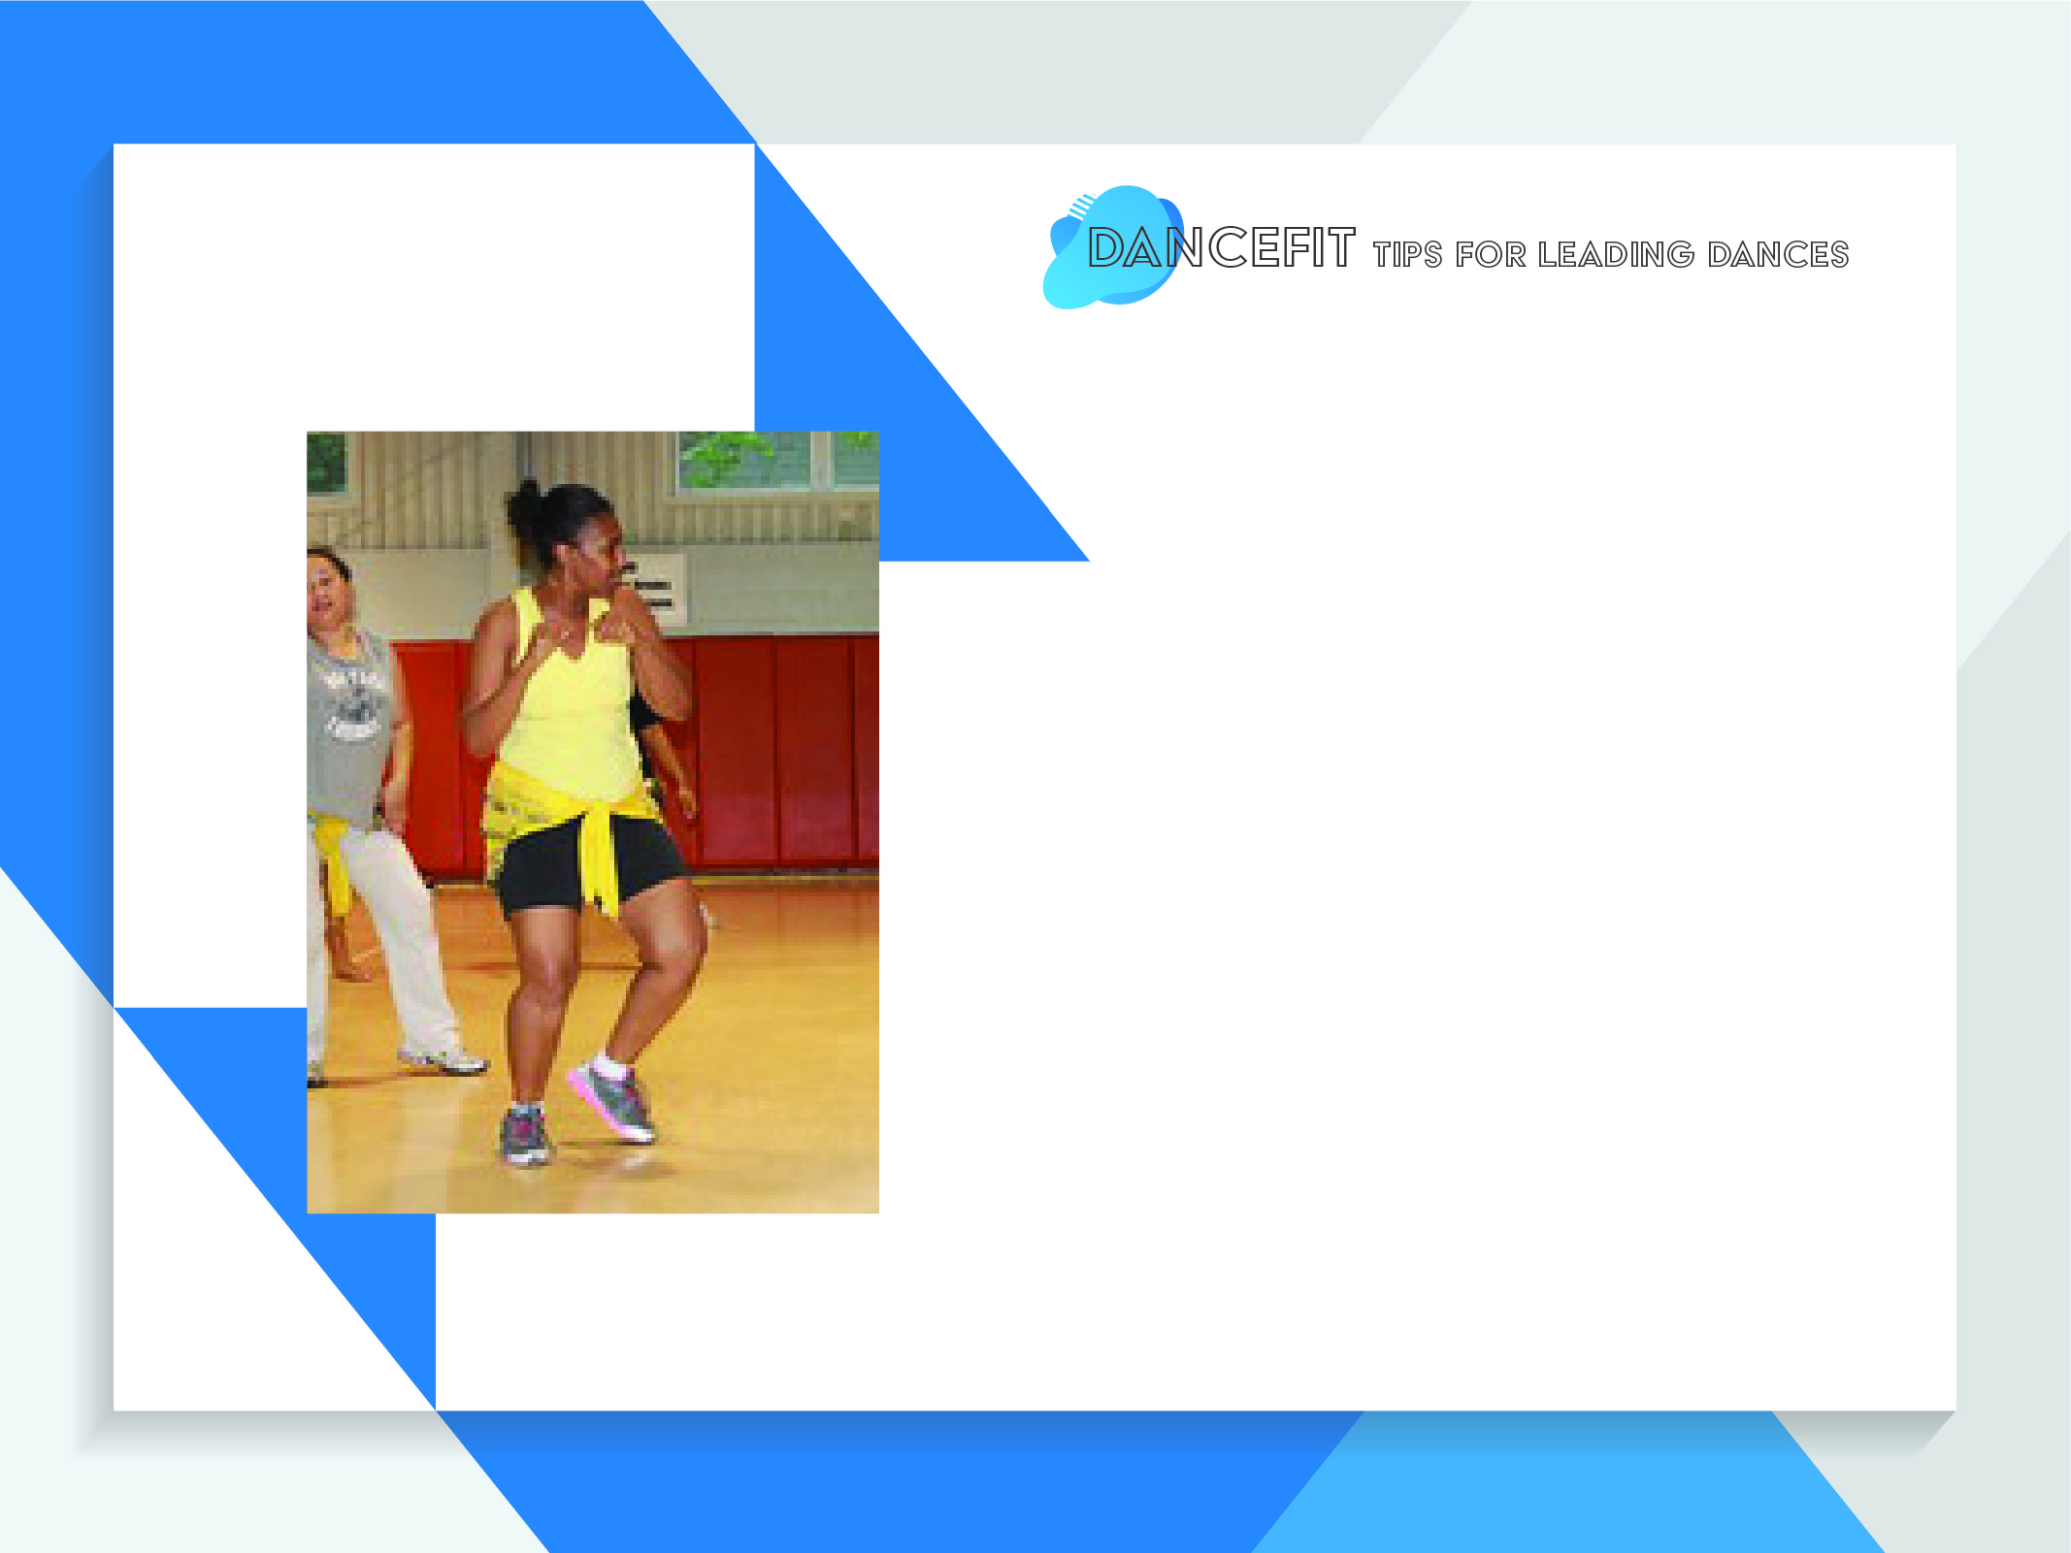
Class Example
30 min. Class
  Choose 1- 2 dances that have minimal or easy to learn steps:
    Objective is explained in the beginning of class
    10 minutes for choreography overview
    3-4 mins. Dance with music
    Water Break then demonstrate and practice 2nd dance (if applicable)
    OR
  1 dance that has more complex steps
    15 mins. Objective and step overview
    10 mins. Dance with music a few times
    5 mins. Water break
40 min.- 1hr Class
  Choose 2-3 easy to learn dances
  Choose 1 or 2 more complex dances
  Follow instructions above
Notes:
“Here is a simple class example that illustrates how to teach the dances in a 30 min class or a 40 min class”
(Go through the bullet points)

Slide 9

  Using 4-H Cooperative Extension, The University of Kentucky
  Most of these dances from 4-H Cooperative Extension are designed for music found on KidzBop 22 (2012). Label : Razor & Tie
  For copyright purposes music used in the instructional videos are Texas A&M Extension approved music.
  Videos best used for review of dance moves.
  Videos are added on a private YouTube channel (must receive link for YouTube access)
Notes:
“In addition to the curriculum we have other supporting resources. Once you have confirmed you will be implementing the dance within your classes, we will provide our Youtube link with instructional videos for each dance.”
(Go through bullet points)

Slide 10

Program
Title
County Extension Nutrition Programs
  Showcase county programs you would like to promote at a local level.
  May delete slide if not applicable

Slide 11

All staff please stand up, spread out on the gym floor and participate
In-Service Dance Choreography Demonstrations
We will be going over 4-8 Dances (depending on allowable time)
  Stronger
  Kung Fu Fighting
  Dance, Dance, Dance
  Eye of the Tiger
  Footloose
  Dynamite
  Celebration
  YMCA
Notes:
“Now the real fun begins! We will be going over a few of the dances from the list presented and I will be demonstrating how a class should be lead.”

Slide 12

123.456.7890
First.last@ag.tamu.edu
www.webadress.com
Notes:
“Any questions?”
(Once questions have been answered or if there are none, if they are sitting down, lead them to area where you will be dancing)

