Slide 1
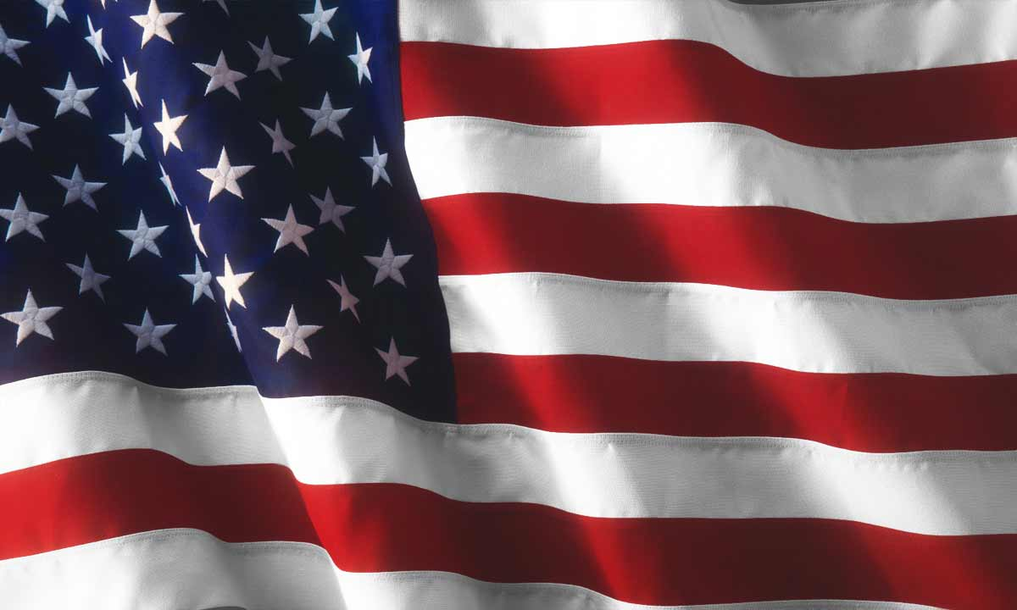

Texas 4-H
Under Our Wings:
Quilts of Valor Program
Angela McCorkle – Extension Program Specialist – 4-H Youth Development
Jheri-Lynn McSwain, Ph.D. – District 5 4-H Specialist
Natalie Cervantes – District 10 4-H Specialist
Feleshia Thompson – Shelby County FCH Agent
Wendy Hatfield-Hazzard - Wheeler County FCH Agent
2024-2025
Notes:
Stand up if you served in any branch of the military.
Stand up if you have any family member that has served in the military.
I would like us to recognize you if you have served for your service
And if you served and have a family member who served, to recognize you for your sacrifice you made to ensure our countries freedoms. Thank you!
Today I want to share with you a new community service project that the 4-H textiles project will be kicking off at the end of February. The program is called Quilts of Valor.
Click

Slide 2
Military Service
Army
Air Force
Navy
Marines
Coast Guard
Space Force
“Not everyone answers the call to serve our country. It is those rare individuals who are selfless enough to sacrifice so much so we can all enjoy the freedom we have. We’ll never know exactly what each Veteran experiences and how they are touched by war. But we can welcome our Veterans home, support them and their families, and thank them for their service whenever possible.”
Lori Thompson Executive Director 2021 - Present

Slide 3
What are Quilts of Valor
Lifetime award
Token of appreciation that says, “thank you for your service, sacrifice and valor.”
Stitched by 4-H youth and adult volunteers with love, prayers and healing thoughts
Sponsored by local businesses, civic clubs and individuals
“Thank you for your service, sacrifice and valor”

Slide 4
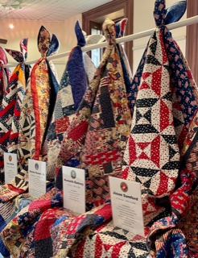
What is the quilt of valor Program
Quilts of Valor Foundation is a non-profit organization (all 50 states)
Over 397,000 quilts have been presented since inception in 2003
Recipients are living local military service members and veterans in good standing

Slide 5
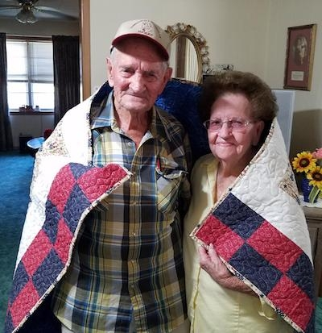
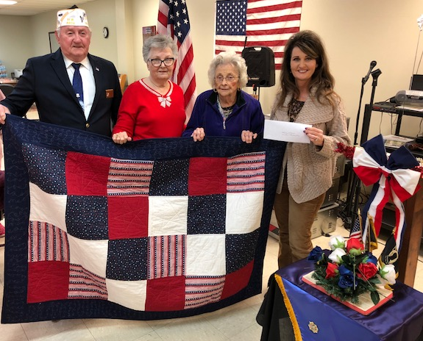
Forming partnerships
4-H Club
Under our Wings Program
VFW Post 8904
Shelby County Veteran’s Office
Shelby TEEA Homemakers Club
Touch a Life

Slide 6

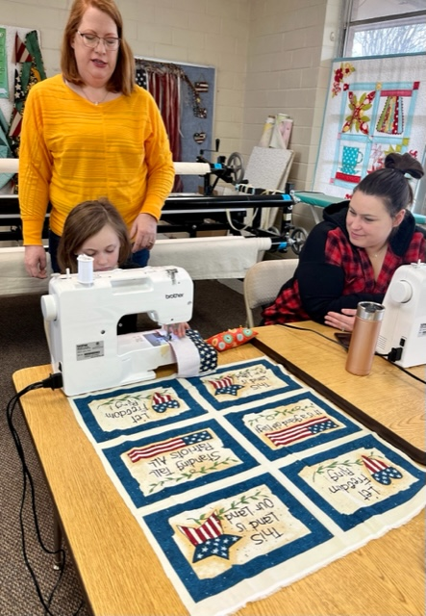
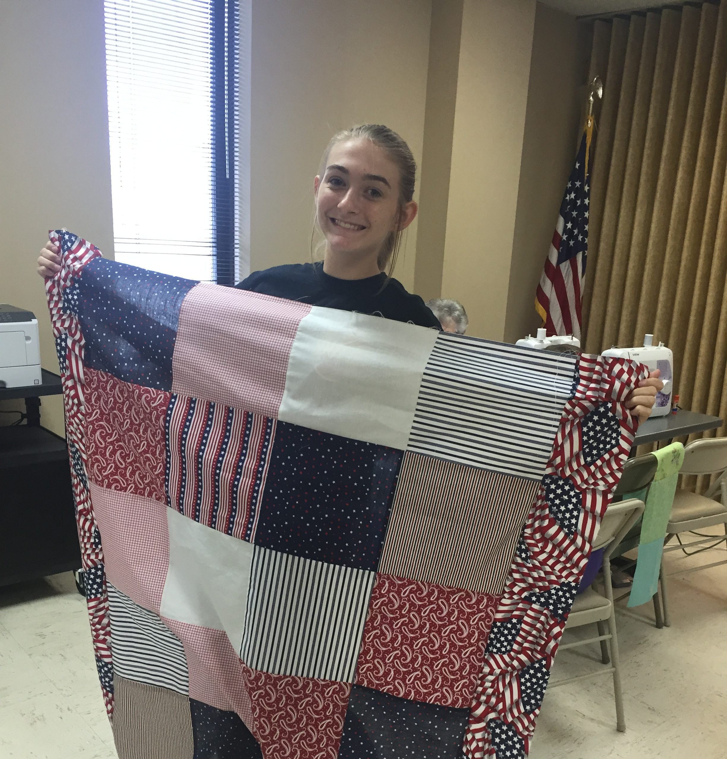
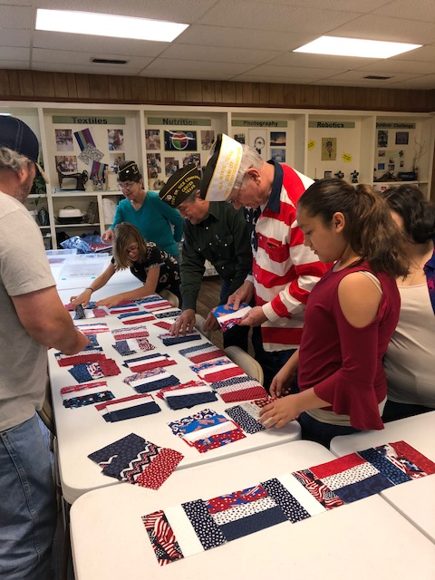
Making the connection
mission
By teaching quilting to 4-H members
And Adult volunteers giving of their time and expertise
Along with support from the local community
We will provide Texas military veterans a quilt of valor

Slide 7
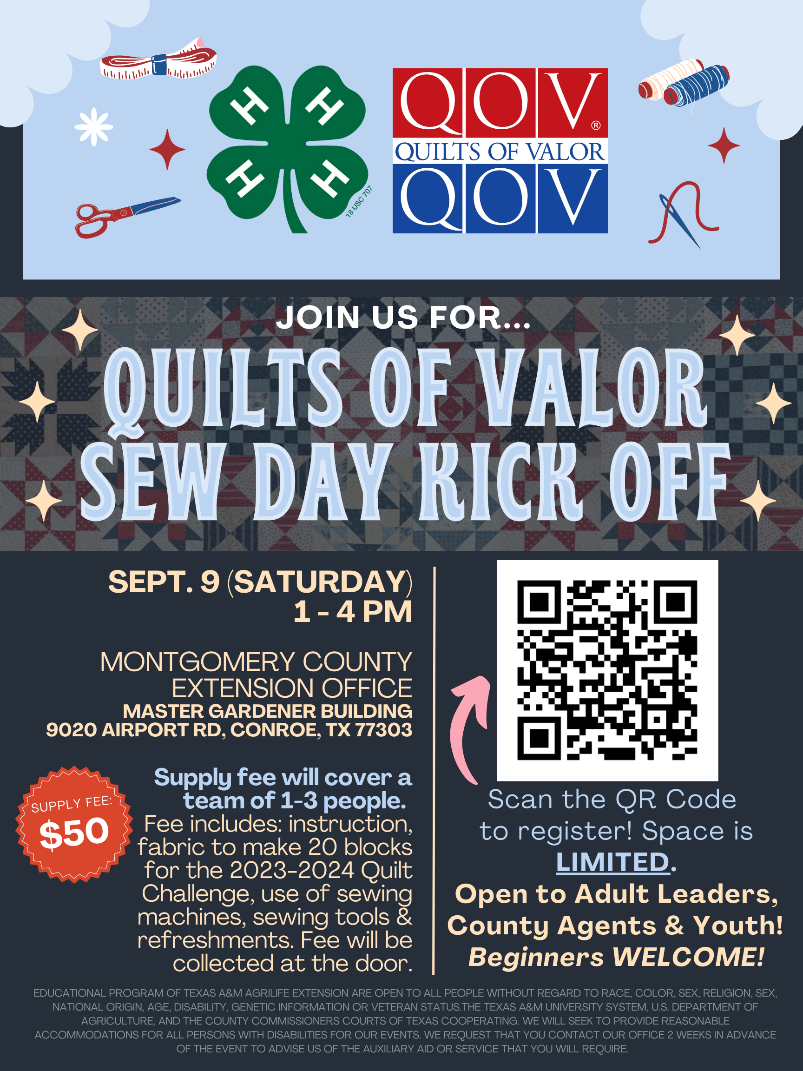
State 4-H Program
Statewide “sew day” and project kick-off – September 9, 2023
Annual quilt top or block challenge by 4-H club
Group of 4-H youth & adults wanting to learn
  Machine sewing
  Leadership
  Community service
  History

Slide 8
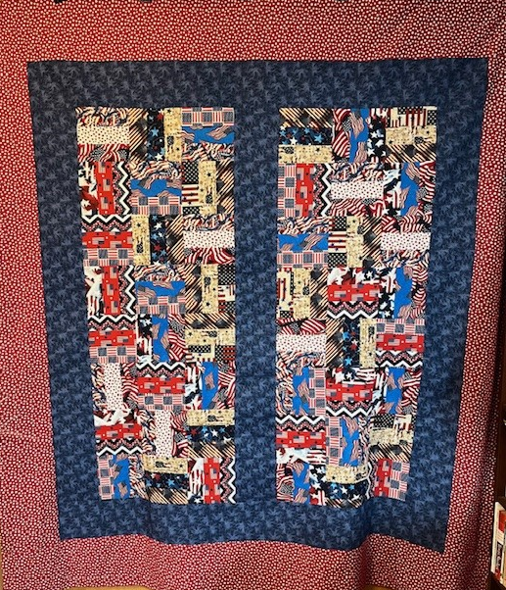
4-H Quilt challenge
Challenge: Block or Top
  Same easy to sew pattern used across state
  Complete designated number of blocks or one top
  Use patriotic themed fabric, 100 % cotton
  Document your project with pictures
2024-2025 Quilt Block Challenge Pattern
“American Made” By Villa Rose

Slide 9
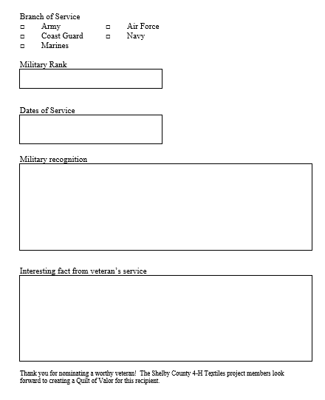
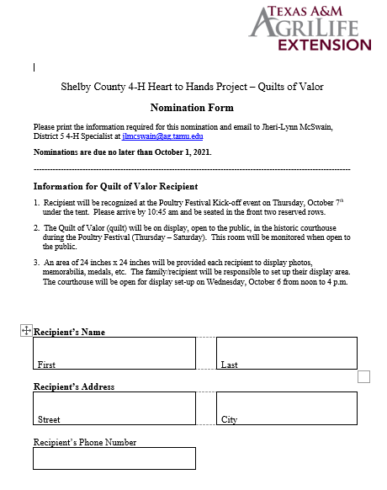
4-H Quilt Challenge
  Locate a local quilter to finish quilt
  Identify a military veteran
  Complete nomination form
  Determine date of award ceremony

Slide 10
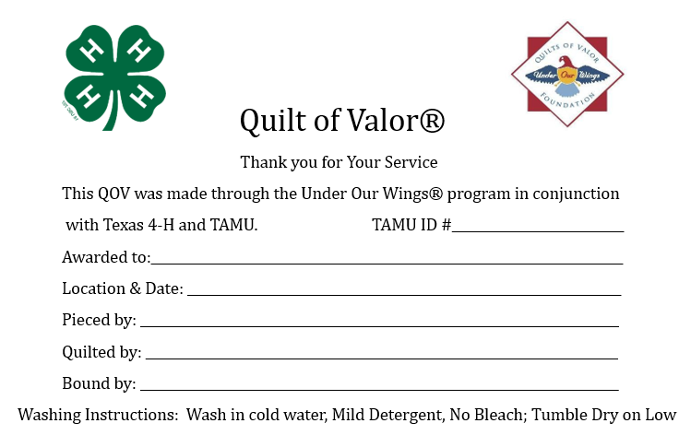
4-H Quilt challenge
  Complete form and receive official 4-H QOV label
  Fill out the label and sew to back of quilt
  Using nomination form, complete award script
  Award your quilt to your nominated veteran!

Slide 11
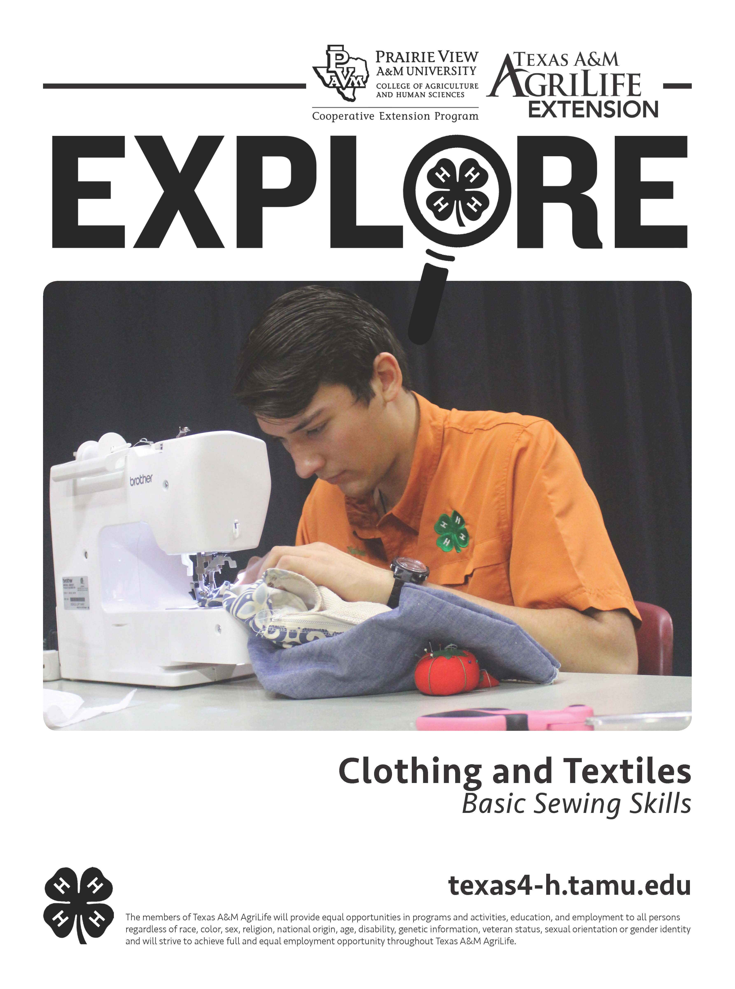
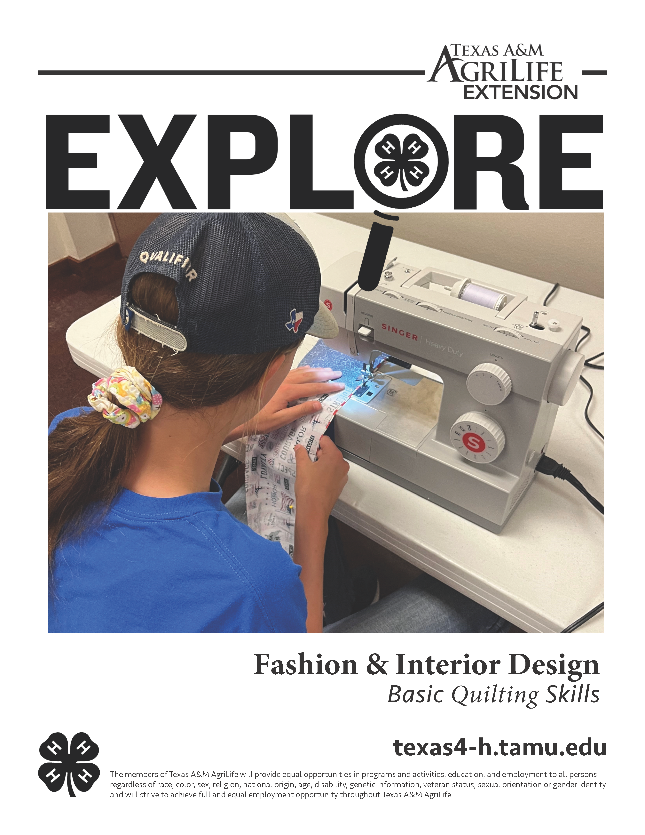
Program resources
  Texas 4-H Website: Fashion & Interior Design Project
  Templates for Sew Day flyer, veteran nomination form, ceremony speech, quilt block and top instructions
  Explore Guides: Basic Sewing Skills, Quilting Skills
  Quilts of Valor Foundation
  Joann’s Mini Grant
  Fabric stores, quilting guilds, TEEA groups, VFW, American Legion, Veteran’s office, county judge, local businesses and civic groups!

Slide 12
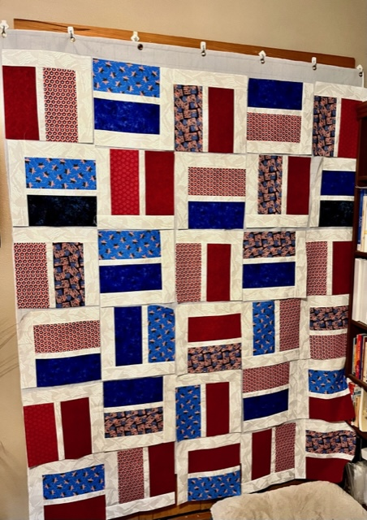
Program Questions?
  https://www.knopnews2.com/2021/04/09/quilts-of-valor/

Slide 13
Make and take a block
  General Instructions
    Pair up with a partner
    Take one baggie with pre-cut fabric
    Sew using ¼ inch seam
    Press your seams to the side
48 three rail fence blocks = 1 quilt top

Slide 14
Make and take a block
  In your baggie you have:
    One RED 2.5 inch wide x ~ 42 inch long strip
    One WHITE 2.5 inch wide x ~ 42 inch long strip
    One BLUE 2.5 inch wide x ~ 42 inch long strip

Slide 15
Make and take a block
  Step 1:
    Use a ¼ inch seam.
    Sew the strips together in this pattern red-white-blue.
    Press all seams toward one side of the strips.
6 ½ inches
40 – 42 inches

Slide 16
Make and take a block
  Step 2:
    Cut sewn strips into 6.5 inch blocks.
    Throw away extra leftover short block.
6 ½ inches
Cut every 6 ½ inches across the width of fabric

Slide 17
Make and take a block
  Step 3:
    Use a ¼ inch seam.
    Sew three blocks together. Turning blocks so that one is horizontal and the next vertical.
    Press seams toward one side.
    Make 8 rows of three blocks.

Slide 18
Make and take a block
  Step 4:
    Use a ¼ inch seam.
    Repeat Step 4 again, so that you have 2 columns of 8 rows x 3 blocks.

Slide 19
Make and take a block
  Step 5:
    Cut border fabric into 6 inch strips by WOF (width of fabric).
    Sew strips end to end to make one long border strip.
    Measure down the center of the quilt top, cut strips to that length.
    Sew one strip to one border column. Sew to other column.
    Sew strips to each side of the quilt top using a ¼ inch seam.
    Press seams to the border.
    Repeat the process with the top and bottom border.

Slide 20
Make and take a block
  Step 6:
  Use 8 strips of 8 inch wide by 42 inch long navy or red fabric.
  Follow instructions in step 5 – inside border to add outside border.
  Press seams to one side of strip.

Slide 21
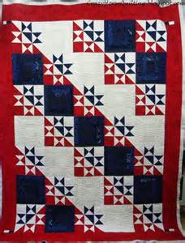
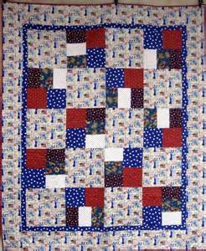
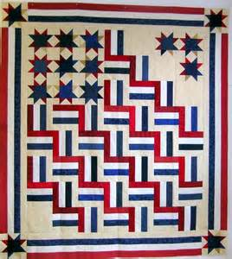
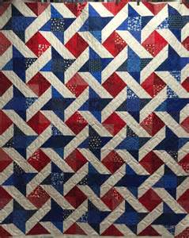
How You can support this program
4-H project club
1
Donate your time to quilt
2
Presentation ceremonies
3
Sponsor a quilt $150
4

Slide 22
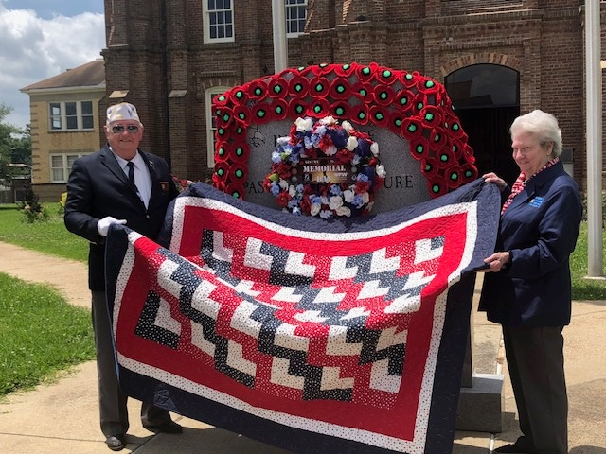
Thank you for making a difference in the life of a veteran and a
4-H member
Jheri-Lynn McSwain, Ph.D.
jlmcswain@ag.tamu.edu
903-834-6191
Questions?

