Slide 1
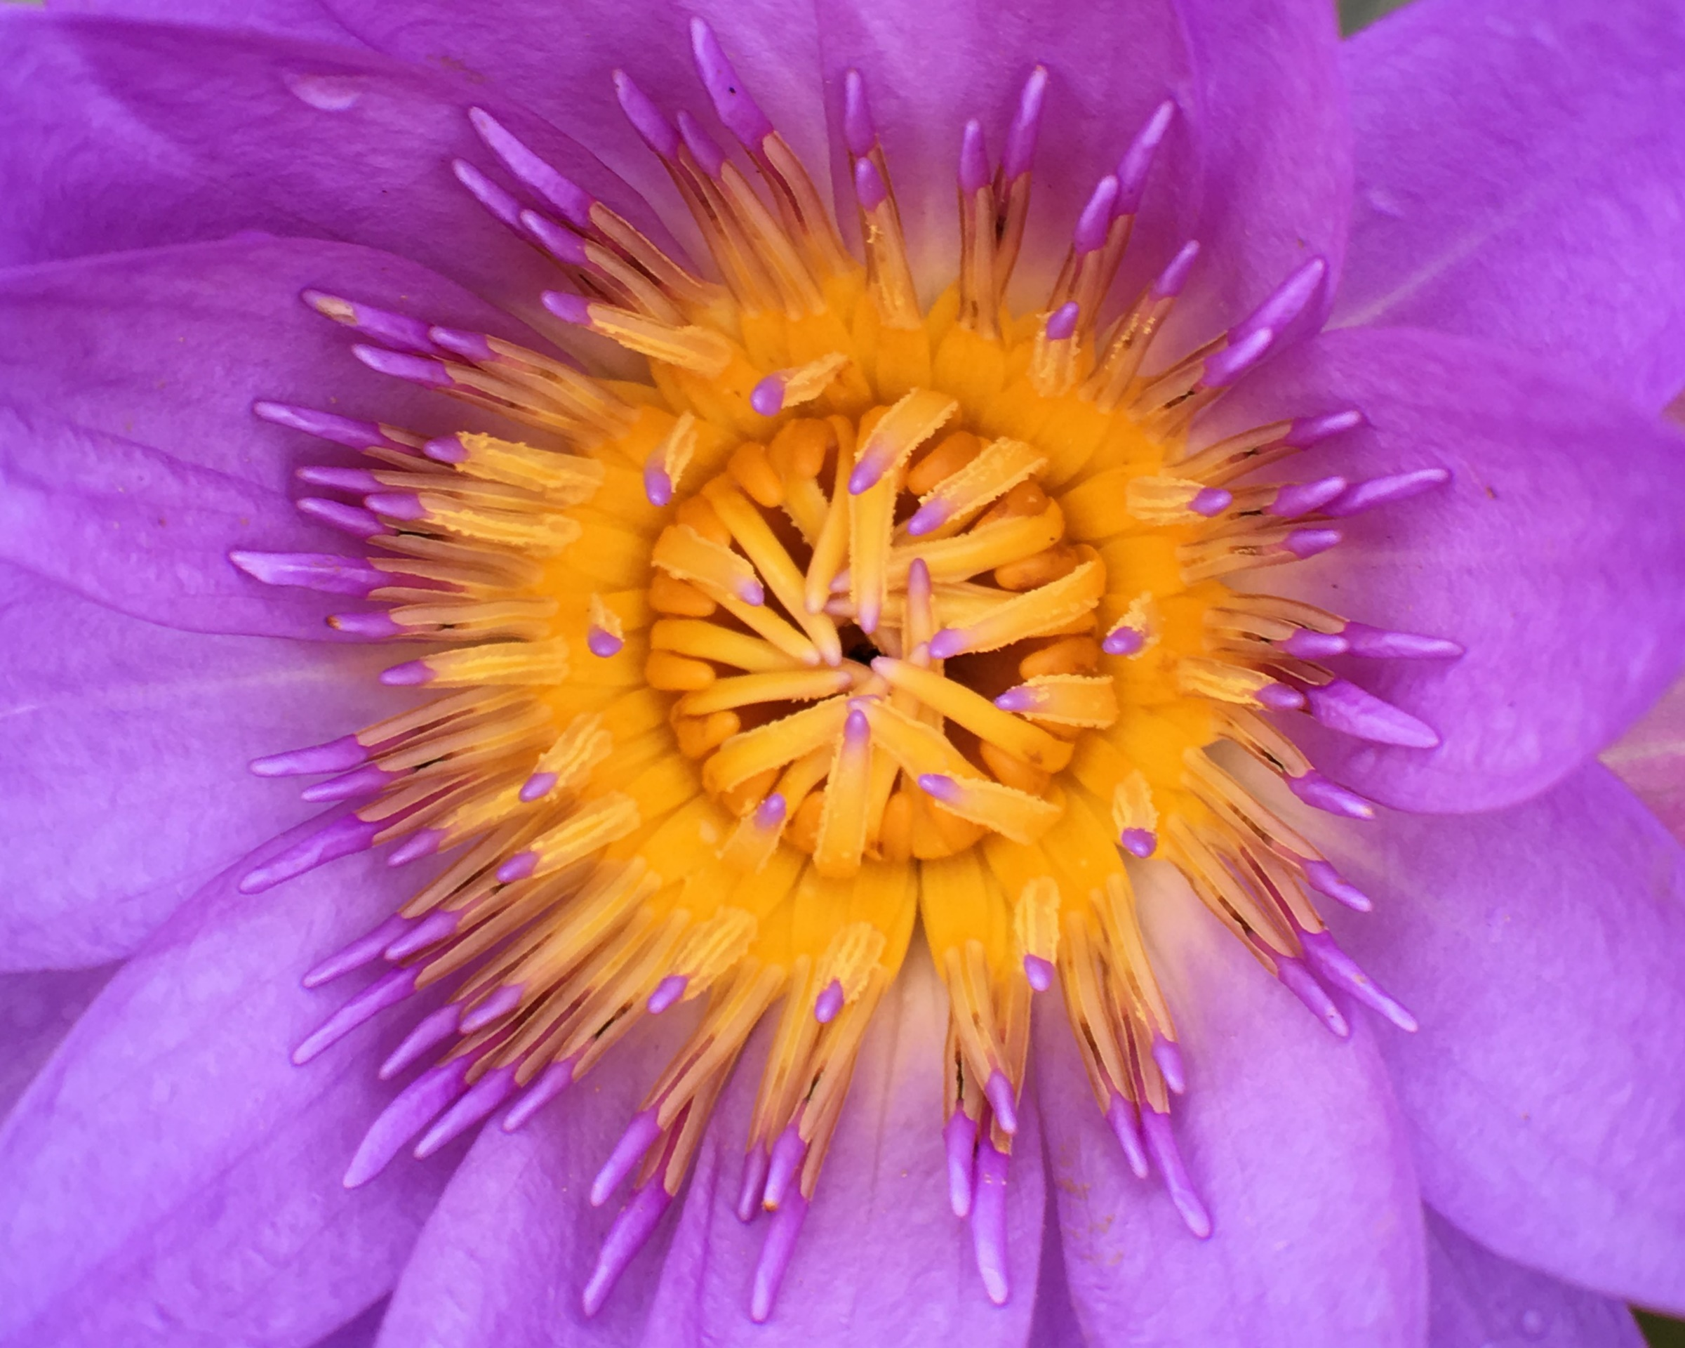
2019 Texas 4-H Photography Judging Contest

Slide 2
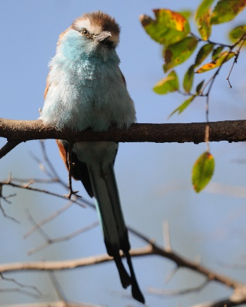
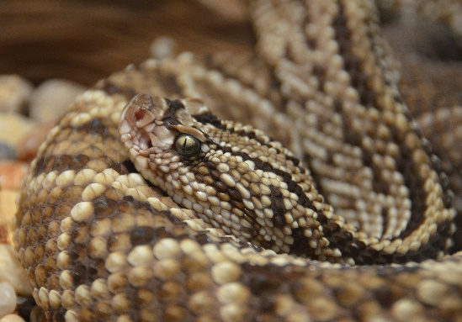
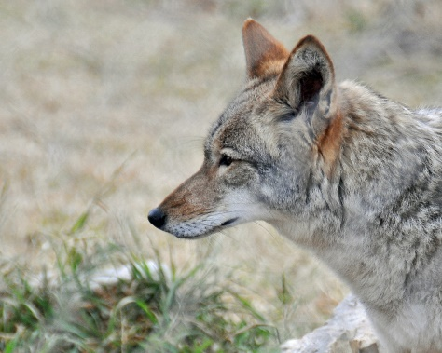
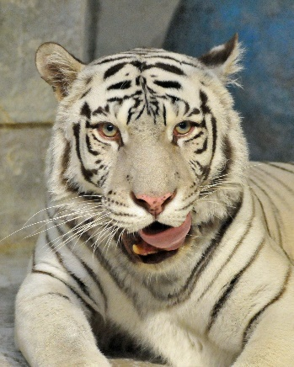
CLASS 1: ANIMALS, WILD JUDGE NOW
1
2
3
4

Slide 3
CLASS 1: ANIMALS, WILD Placing: 4, 2, 1, 3 Cuts 3, 1, 4
4
2
1
3

Slide 4
4
2
1
3
Class #1 | Animals, Wild
Placing | 4-2-1-3
Cuts | 3-1-4
#4 | Excellent capture of tongue in motion Clear photo with simple background Eyes on third of frame
#2 | Snake head very clear and detailed Foreground out of focus
#1 | Detailed feathers and eye Leaves on right out of focus Shadows on underbelly and tail
#3 | Clear photo of coyote but uninteresting composition Does not spark any emotion

Slide 5
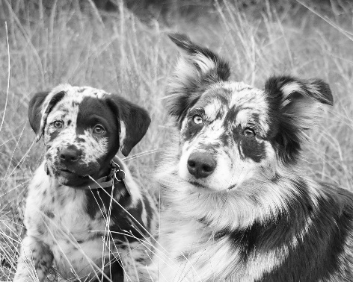
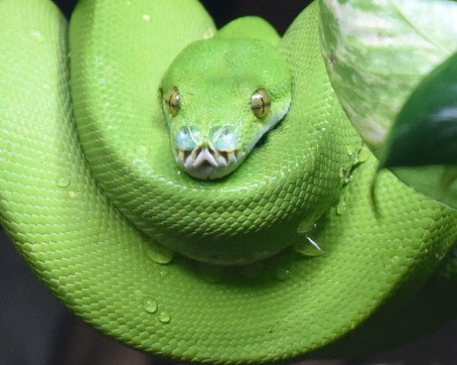
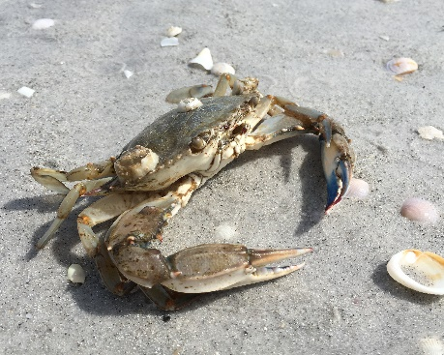
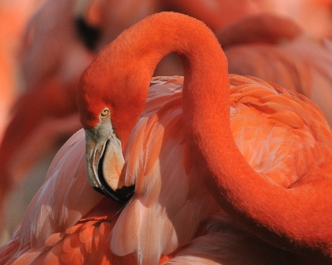
CLASS 2: DOMINANT COLOR JUDGE NOW
1
2
3
4

Slide 6
CLASS 2: DOMINANT COLOR Placing: 3, 4, 2, 1 Cuts 1, 2, 6
3
4
2
1

Slide 7
3
4
2
1
Class #2 | Dominant Color
Placing | 3-4-2-1
Cuts | 1-3-6
#3 | Composition is excellent Very clear details in crab as well as sand/shells
#4 | Shallower depth of field would help bring more focus to head and eyes Good composition Excellent lighting
#2 | Leaf in foreground distracting Excellent focus on snake with good composition Edge merger at bottom
#1 | Disqualified Black and White photos cannot be entered into dominant color category

Slide 8
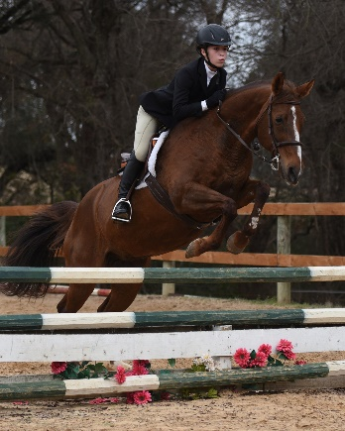
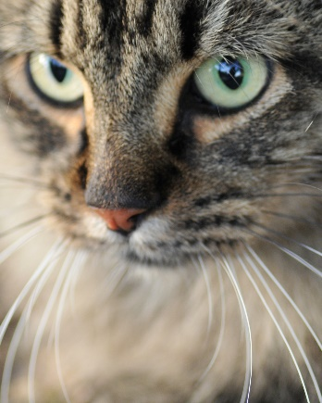
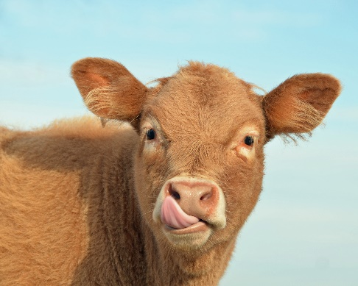
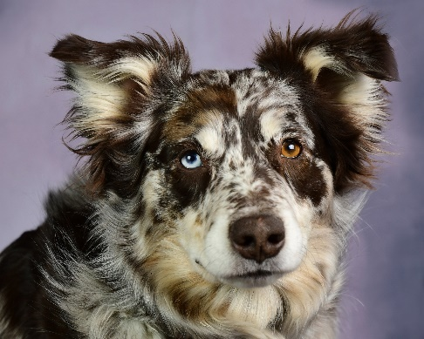
CLASS 3: ANIMALS, DOMESTIC JUDGE NOW
1
2
3
4

Slide 9
CLASS 3: ANIMALS, DOMESTIC Placing: 2, 3, 1, 4 Cuts 2, 4, 4
2
3
1
4

Slide 10
2
3
1
4
Class #3 | Animals, Domestic
Placing | 2-3-1-4
Cuts | 2-4-4
#2 | Eyes crystal clear Excellent lighting
#3 | Good action capture Background distracting – shallower depth of field needed
#1 | No catchlight in eyes flattens photo Good color contrast
#4 | Focus is above eye not the eye itself

Slide 11
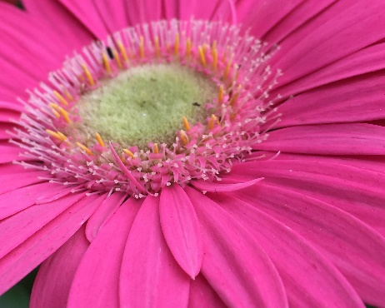
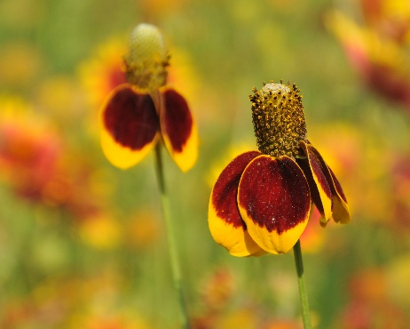
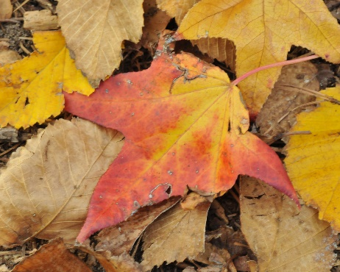
CLASS 4: Plants JUDGE NOW
1
2
3
4

Slide 12
CLASS 4: Plants Placing: 2, 1, 3, 4 Cuts 2, 2, 5
2
1
3
4

Slide 13
2
1
3
4
Class 4 | Plants
Placing | 2-1-3-4
Cuts | 2-2-5
#2 | Excellent composition Shallow depth of field helps focus on front flower
#1 | Interesting composition Sharp focus on petals leading to center
#3 | Good focus Centered composition is uninteresting
#4 | Blurry Uninteresting

Slide 14
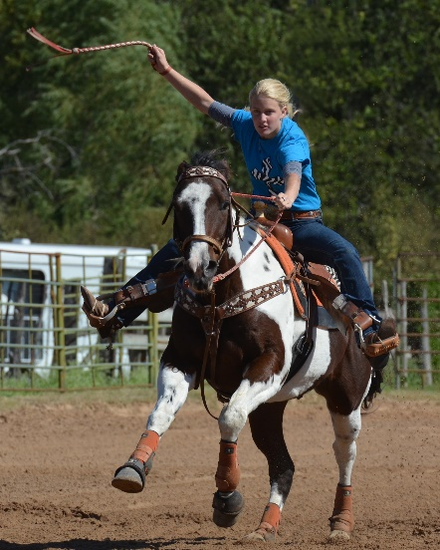
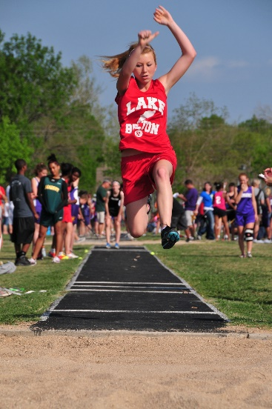
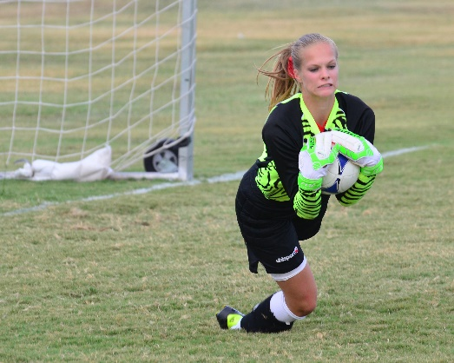
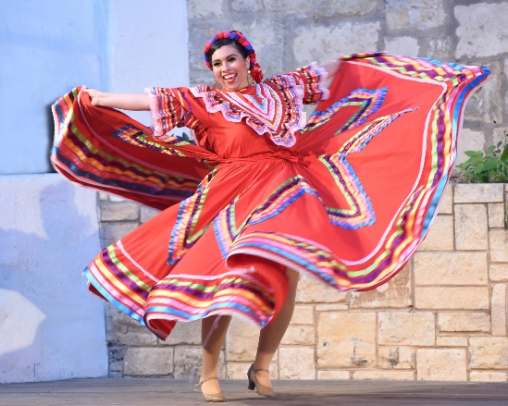
CLASS 5: Sport JUDGE NOW
1
2
3
4

Slide 15
CLASS 5: Sport Placing: 4, 3, 2, 1 Cuts 3, 2, 4
4
3
2
1

Slide 16
4
3
2
1
Class 5 | Sport
Placing | 4-3-2-1
Cuts | 3-2-4
#4 | Frame filled Clear focus with just a little motion blur to indicate movement Good movement into space with negative area on left of frame
#3 | Strong composition Hands slightly blurred A shallower depth of field would have helped focus on jumper
#2 | Excellent focus Dark/shadows on face Cropping is too close – need more space for horse to move into
#1 | Soft focus Soccer player too close to right of frame

Slide 17
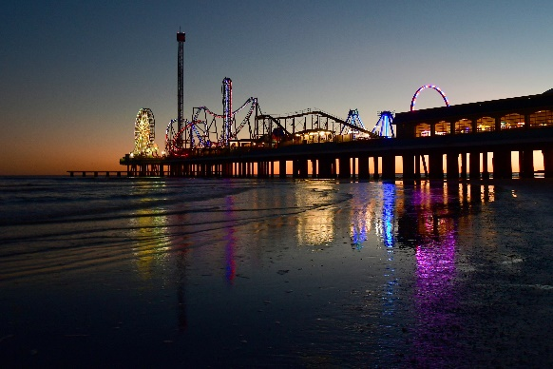
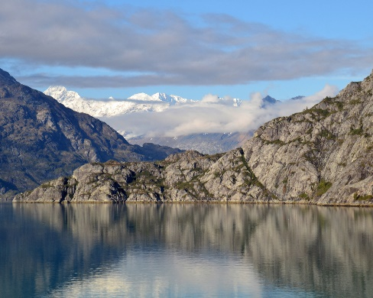
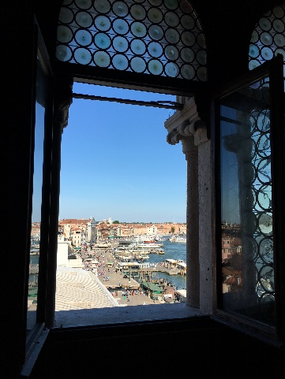
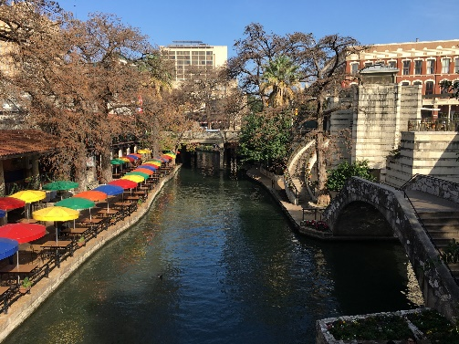
CLASS 6: Travel JUDGE NOW
1
2
3
4

Slide 18
CLASS 6: Travel Placing: 1, 2, 4, 3 Cuts 2, 5, 2
1
2
4
3

Slide 19
1
2
4
3
Class 6 | Travel
Placing | 1-2-4-3
Cuts | 2-5-2
#1 | Excellent leading lines with lights on the sand going up to the pier Photo in perfect focus
#2 | Beautiful mirrored photo Horizon should be a little higher to get the full mirrored effect
#4 | Strong leading lines but no point of interest Shadows on bridge makes it hard to see
#3 | Nice framing, but angle makes it hard to see subject (Italian marina)

Slide 20
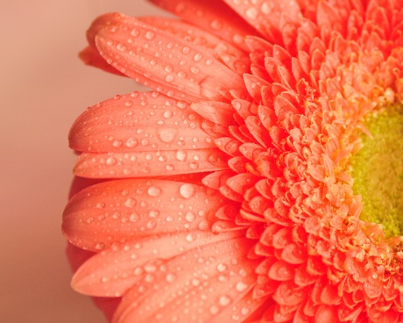
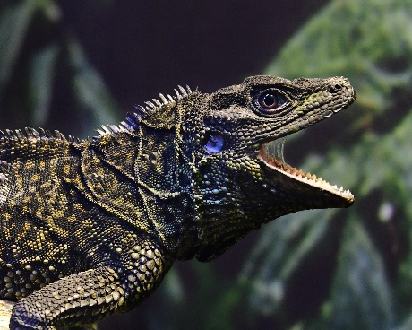
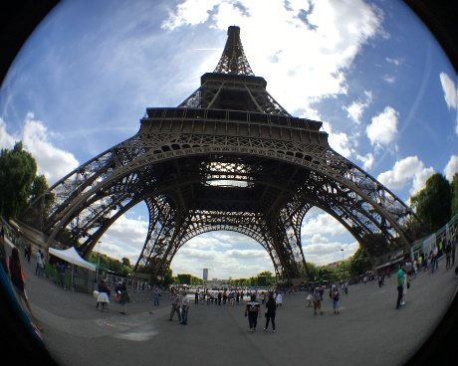
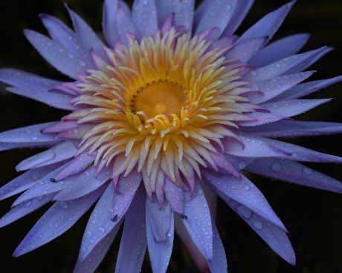
CLASS 7: Questions JUDGE NOW 10 Points Each
1
2
3
4
Which photo is the best example of dominant analogous color?
Which photo is the best example of the use of water to pop the photo?
Which photo is underexposed?
Which photo was taken using a fisheye lens?

Slide 21
CLASS 7: Questions Placing: 1, 4, 2, 3 10 Points Each
1
4
2
3
Dominant analogous color
Water to pop color
Underexposed
Fish eye lens

Slide 22
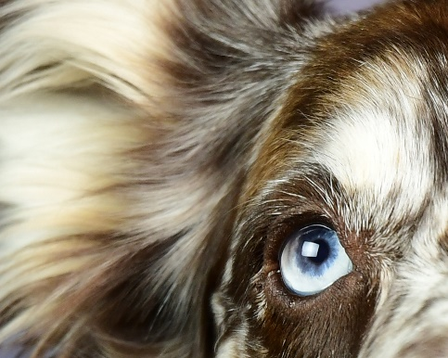
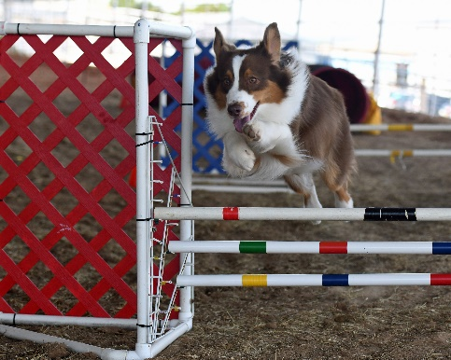
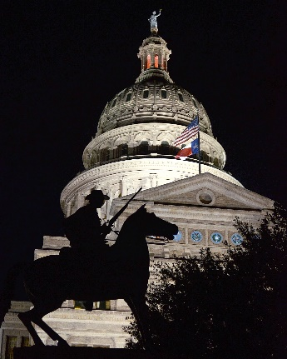
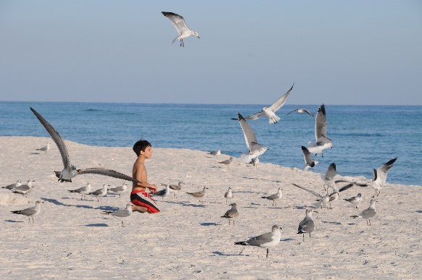
CLASS 8: Questions JUDGE NOW 10 Points Each
1
2
3
4
Which photo used the following manual camera settings? f/5.3, 1/30, ISO 1600
Which photo used the following manual camera settings? f/13, 1/400/ISO 200
Which photo used the following manual camera settings? f/2.8, 1/100, ISO 500
Which photo used the following manual camera settings? f/3.5, 1/800, ISO 500

Slide 23
CLASS 8: Questions Placing: 3, 4, 1, 2 10 Points Each
3
4
1
2
f/5.3, 1/30, ISO 1600
f/13, 1/400/ISO 200
f/2.8, 1/100, ISO 500
f/3.5, 1/800, ISO 500

